Slide 1
Why History?
Those who do not remember the past are condemned to repeat it. - George Santayana
Human history becomes more and more a race between education and catastrophe. - H.G. Wells

Slide 2
Why do we study history?
Notes:
Ask kids for a response to video

Slide 3
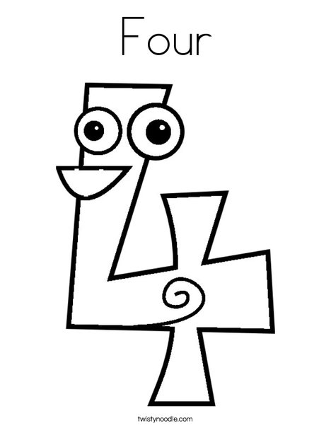
The FOUR reasons
why Mrs. Riddle loves history
and wants to share her
knowledge and opinions with you

Slide 4
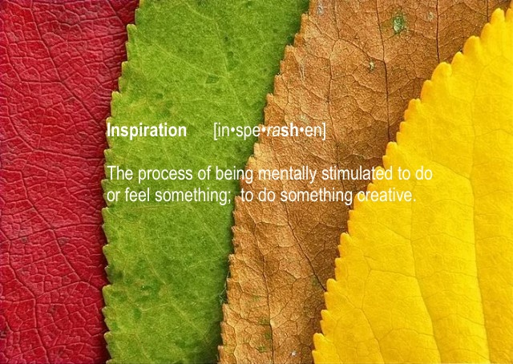
Inspiration

Slide 5
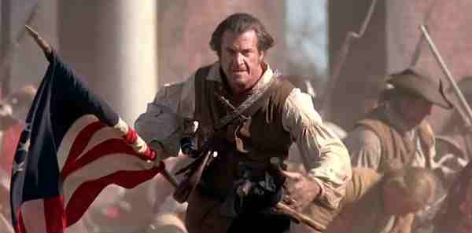
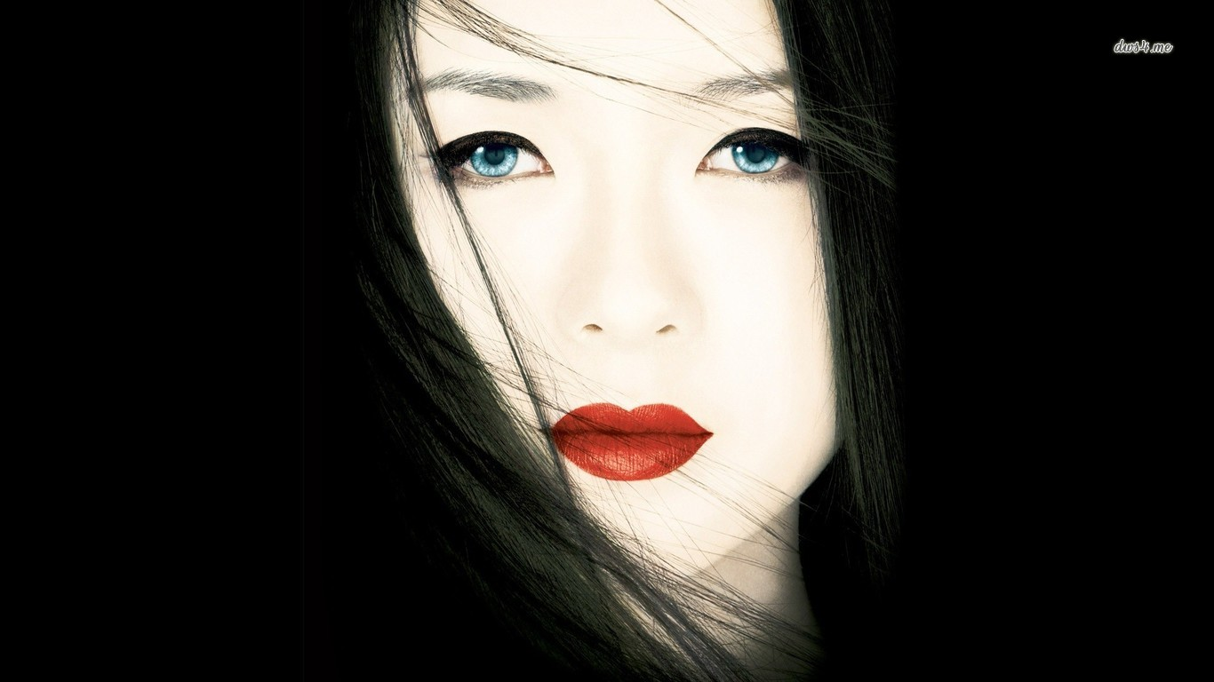
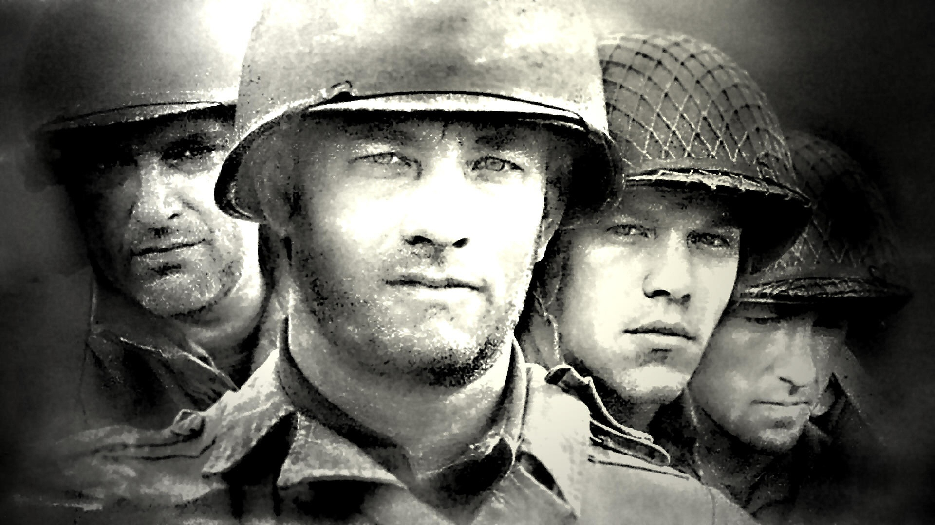
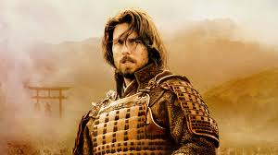
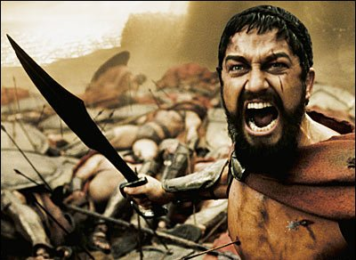
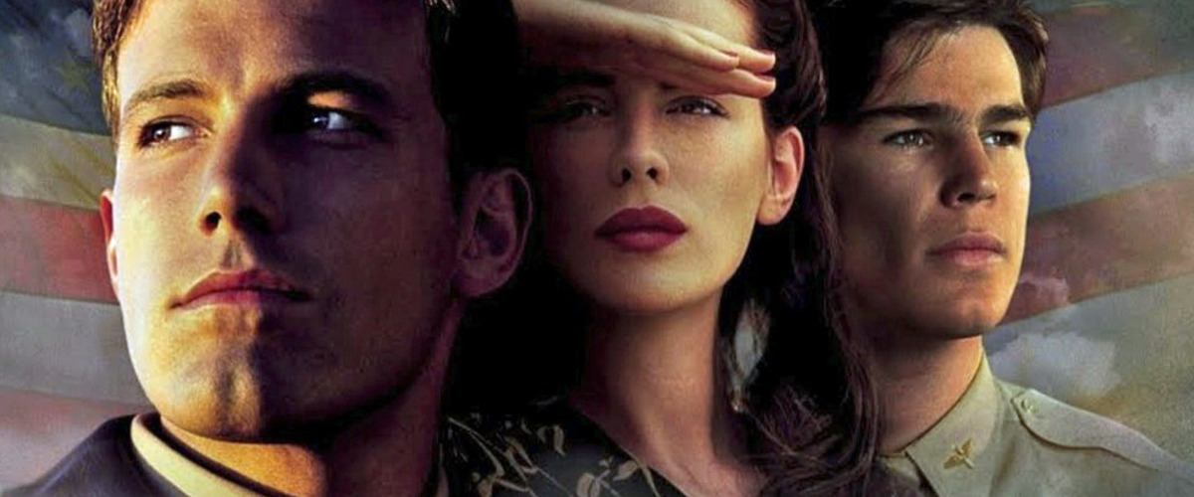
Hollywood Loves History!

Slide 6
Empathy

Slide 7
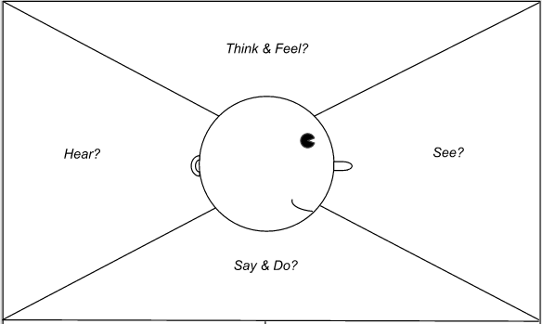
Steps of empathy
Listen
Open Up
Withhold Judgement
Offer help

Slide 8
Critical Thinking Skills

Slide 9
Good critical thinkers ask:
Who said that?
Is that source reliable?
Do you have data supporting that claim?
Has that been scientifically proven?
Are you qualified to speak on this topic?
Do you have a personal stake in the issue?

Slide 10
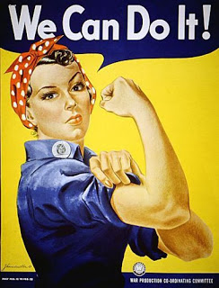
Create

Slide 11
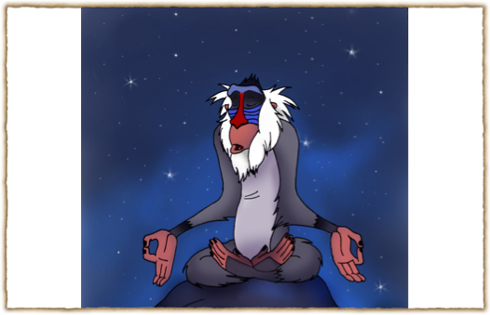
Rafiki
says....
Don't run from it!
Learn from it!

Slide 12
Create
Think Critically
Empathy
Inspiration

