Slide 1
Religion
R

Slide 2
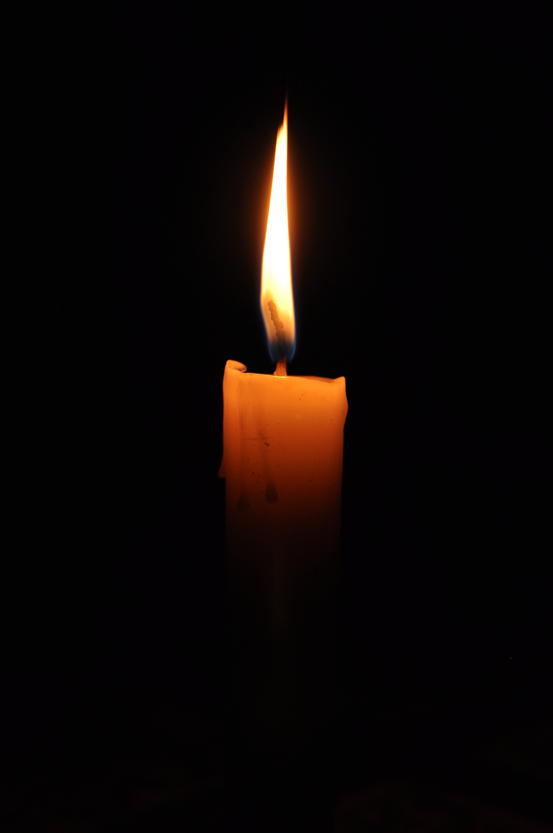
Just as a candle cannot burn without fire, men cannot live without a spiritual life. - Buddha
Ingrained into mankind is the need to explain where we came from, why we are here, and where we are going. So we create narratives, symbols, and sacred histories. We congregate together and pass these stories onto our children. From these beliefs about the cosmos and human nature, people derive morality, ethics, religious laws or a preferred lifestyle.

Slide 3
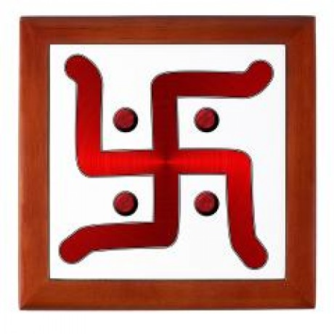
Islam
Hinduism
Christianity
Buddhism
Taoism
Judaism
Sikhism

Slide 4
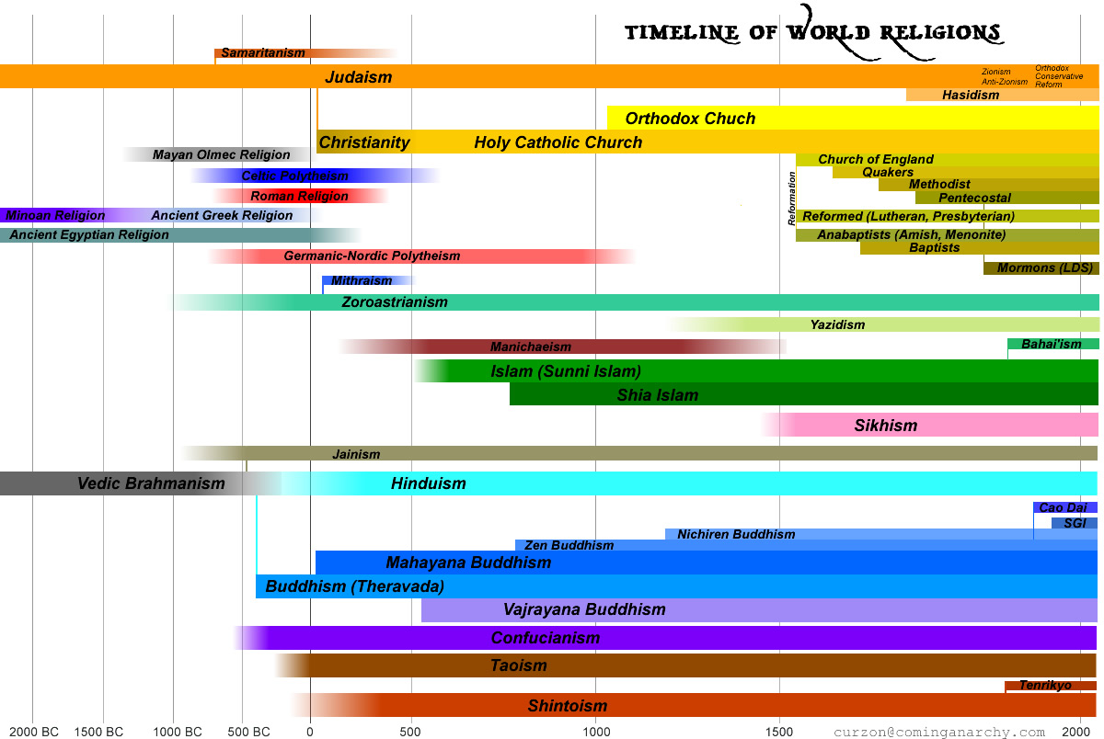

Slide 6
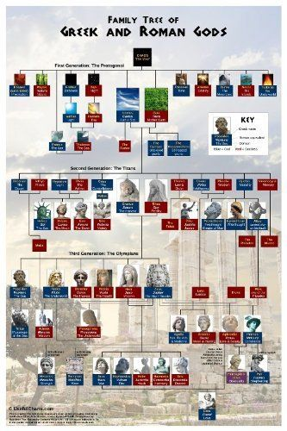
Expectations
Monotheism
Polytheism

Slide 7
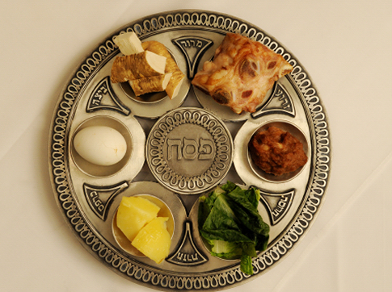
Name
Name and give a brief description of the deity worshiped
Lifestyle
Be able to write a paragraph describing how their religion affected their daily lives.
Notes:
Plate represents foods eaten during the Jewish Holiday of passover.
Meditation - religion changes your lifestyle
Expectations - Throughout civilizations you will be able to describe the religion and how it affected that civilizations culture.

Slide 8
Homework
Choose a religion
Research a related architectural building or site
Copy/Paste at least one picture onto page
Write two paragraphs, one describing the building or site, and one paragraph on the significance to the religion
Due FRIDAY

Slide 9
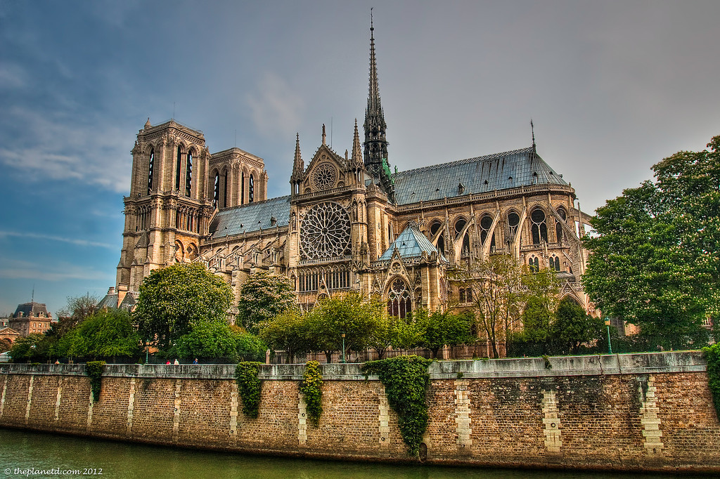
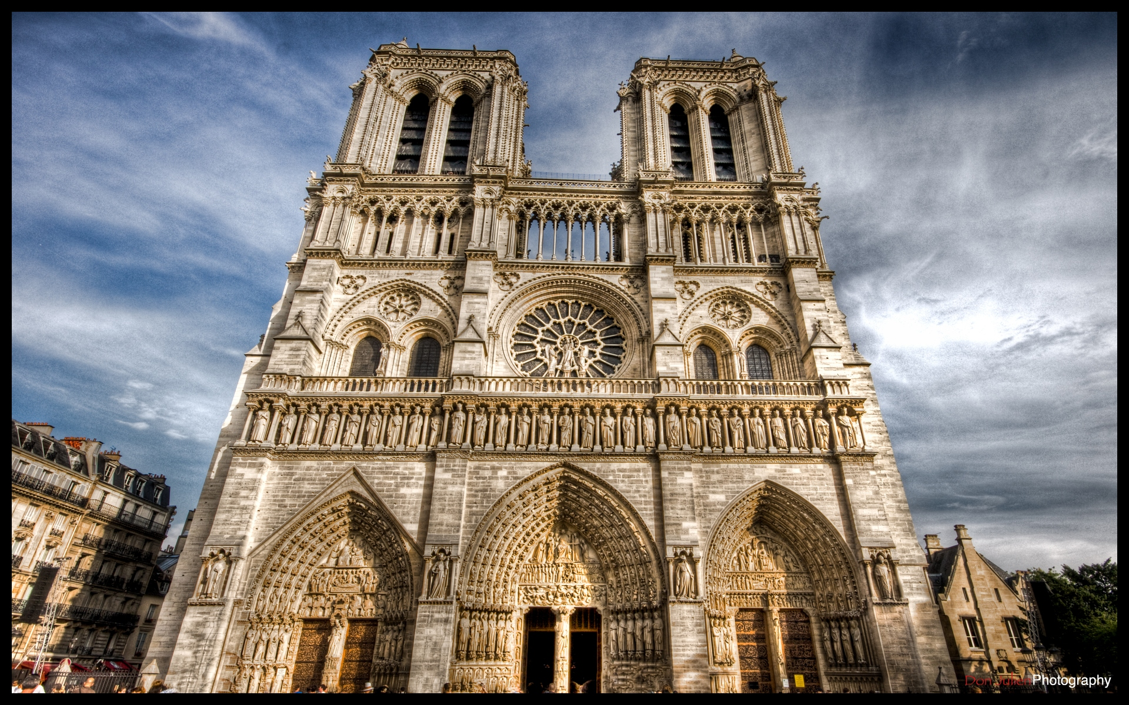
Example : Notre Dame
Description: A historic Catholic Cathedral in Paris France
Significance: official seat of the archbishop of Paris, famous reliquary and site of many historical events

