Slide 1
Primary and Secondary Sources

Slide 2
What is the difference?
Secondary sources
Interprets and analyzes primary sources. These sources are one or more steps removed from the event.
Primary sources
Sources are a document or physical object which was written or created during the time of study.
Notes:
Secondary source – hearsay

Slide 3
Primary Source
Original documents (excerpts for translations acceptable): diaries, speeches, manuscripts, letters, interviews, news film footage, autobiographies, official records, photos
Creative works: poetry, drama, novels, music, art, essays, plays
Relics or artifacts: pottery, furniture, clothing, buildings, weapons, any old physical object.

Slide 4
Secondary source
Publications: textbooks, magazine articles, histories, criticisms, commentaries, encyclopedias, interpretive journals, history textbook, biographies

Slide 5
Video

Slide 6
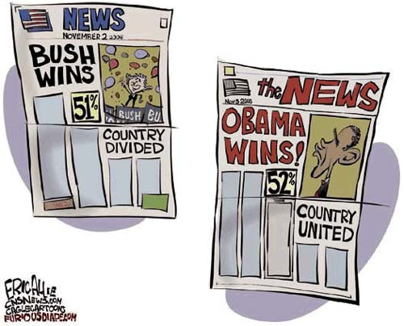
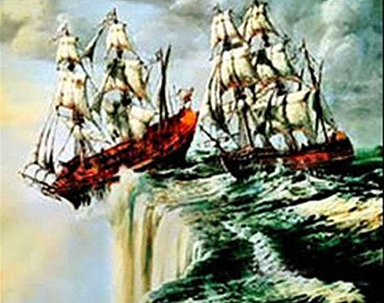
Is it C.R.A.B.?
Current
Reliable
Authentic
Bias
Notes:
World is flat theory- don't want to grab a 1950 encyclopedia, because they have found more current info since then.
Holiday inn- Primary source: hearsay. Farther away from source the less reliable. Secondary source: authority. Degree? Hobby?
Downton Abbey- plastic water bottle/not authentic.
Political cartoon- one percentage changes view

Slide 7
Is it C.R.A.B?

