Slide 2
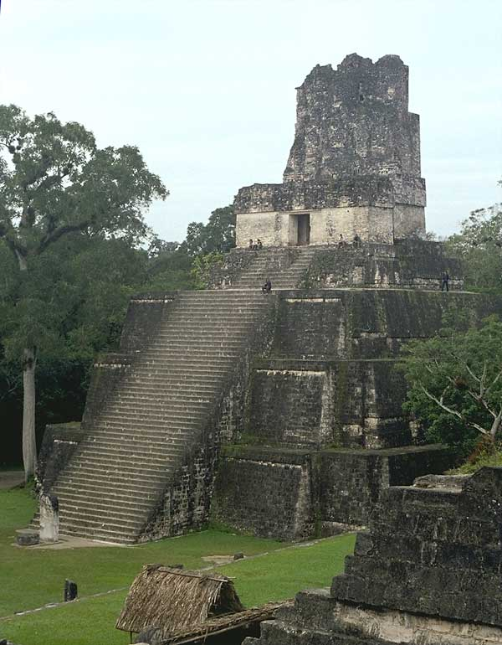
Weighing the Evidence
Robin Hood
WEIGH
EVIDENCE
THE
The Mayans
Notes:
For each provided exhibit students rate it -2 to +2 based on how much it supports the question “Were the Mayans an advanced society?” At the end add up all the values to determine which side the evidence supports.
Exhibits:
Ancient Aliens clip
Various DBQ docs
Failed calendar predictions
Writing system
math

Slide 3
Instructions
- Rate each of the following exhibits based on how well it supports the statement:
“The Mayans were an advanced civilization.”
-Each exhibit is rated from -2 (very against the statement) to + 2 (very supportive of the statement)
-A rating of 0 means the source is not useful or reliable.
-For each write one or two sentences defending your rating.

Slide 4
Set up your paper into columns like this:
Exhibit
Rating
Why?
Z – Photograph
of forest
+1
Stories of bigfoot often say he lives in the forest. This is actually a forest so the stories are somewhat believable.

Slide 5
Not all evidence is equally important. Part of drawing a conclusion is determining how much weight you give to each bit of information.
EVIDENCE
EVIDENCE
-2
Heavily against
-1
Slightly against
0
No
value as a source
+1
Slightly for
+2
Heavily for

Slide 6
Exhibit A:
Personal Testimony

Slide 7
Why did the Mayans have so much technology?
Uh…. They didn’t. At their peak - AD 250-900 they were essentially still a largely stone-age society - no wheels, no bronze let alone iron, no metal tools or weapons, no understanding of pulleys or block & tackle, no wind or water mills, no kilns or fired ceramics, no ships or ocean-born trade, and only the crudest most basic form of leather-working. They did have a kind of paper, but then so did the Chinese (several centuries earlier).
Stormarm from www.answerbag.com

Slide 8
Exhibit b:
Graphic from Textbook

Slide 9
Notes:
Holt’s World History Medieval to Early Modern Times, 2006.

Slide 10
Exhibit c:
Mayan carving

Slide 11
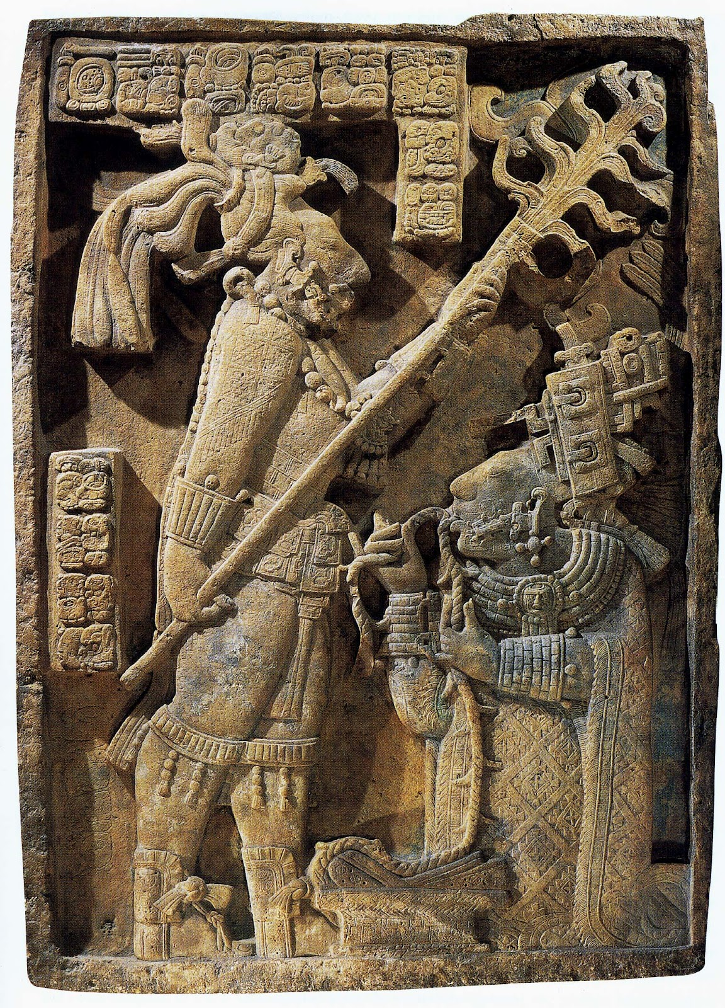

Slide 12
Exhibit d:
Modern book

Slide 13
The Maya hieroglyphic writing is arguably one of the most visually striking writing systems
of the world. It is also very complex, with hundreds of unique signs or glyphs in the form of
humans, animals, supernaturals, objects, and abstract designs. These signs are either
logograms (to express meaning) or syllabograms (to denote sound values), and are used to
write words, phrases, and sentences. In fact, the Maya can write anything that they can say.
Ancient Scripts, S. McKnight, 1999.
Exhibit M:
Modern book
Notes:
Something about math?

Slide 14
Exhibit e:
Images of Mayan Nobles from Apocalypto (2006)

Slide 15
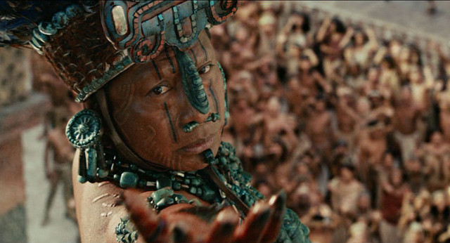

Slide 16
Exhibit f:
Mayan Numbers

Slide 17
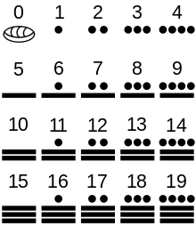
Notes:
buildings

Slide 18
Instructions
Add up all of your rating numbers from the exhibits. If your rating is positive he is real. If it is negative he is fictional.
Write an ARE answering: “Were the Mayans an advanced civilization?”
Assertion- The Mayans were/were not an advanced civilization.
Reason- The evidence shows…
Evidence x 3- For example in Exhibit…

