Slide 1
Life of Muhammad

Slide 2
Born in 570 ad. in Mecca to Abdullah and Amina
Believed to be a descendant of Ibrahim through his first son Ishmael
His father dies before he is born returning from a trade journey to Syria. He is buried in Medina.

Slide 3
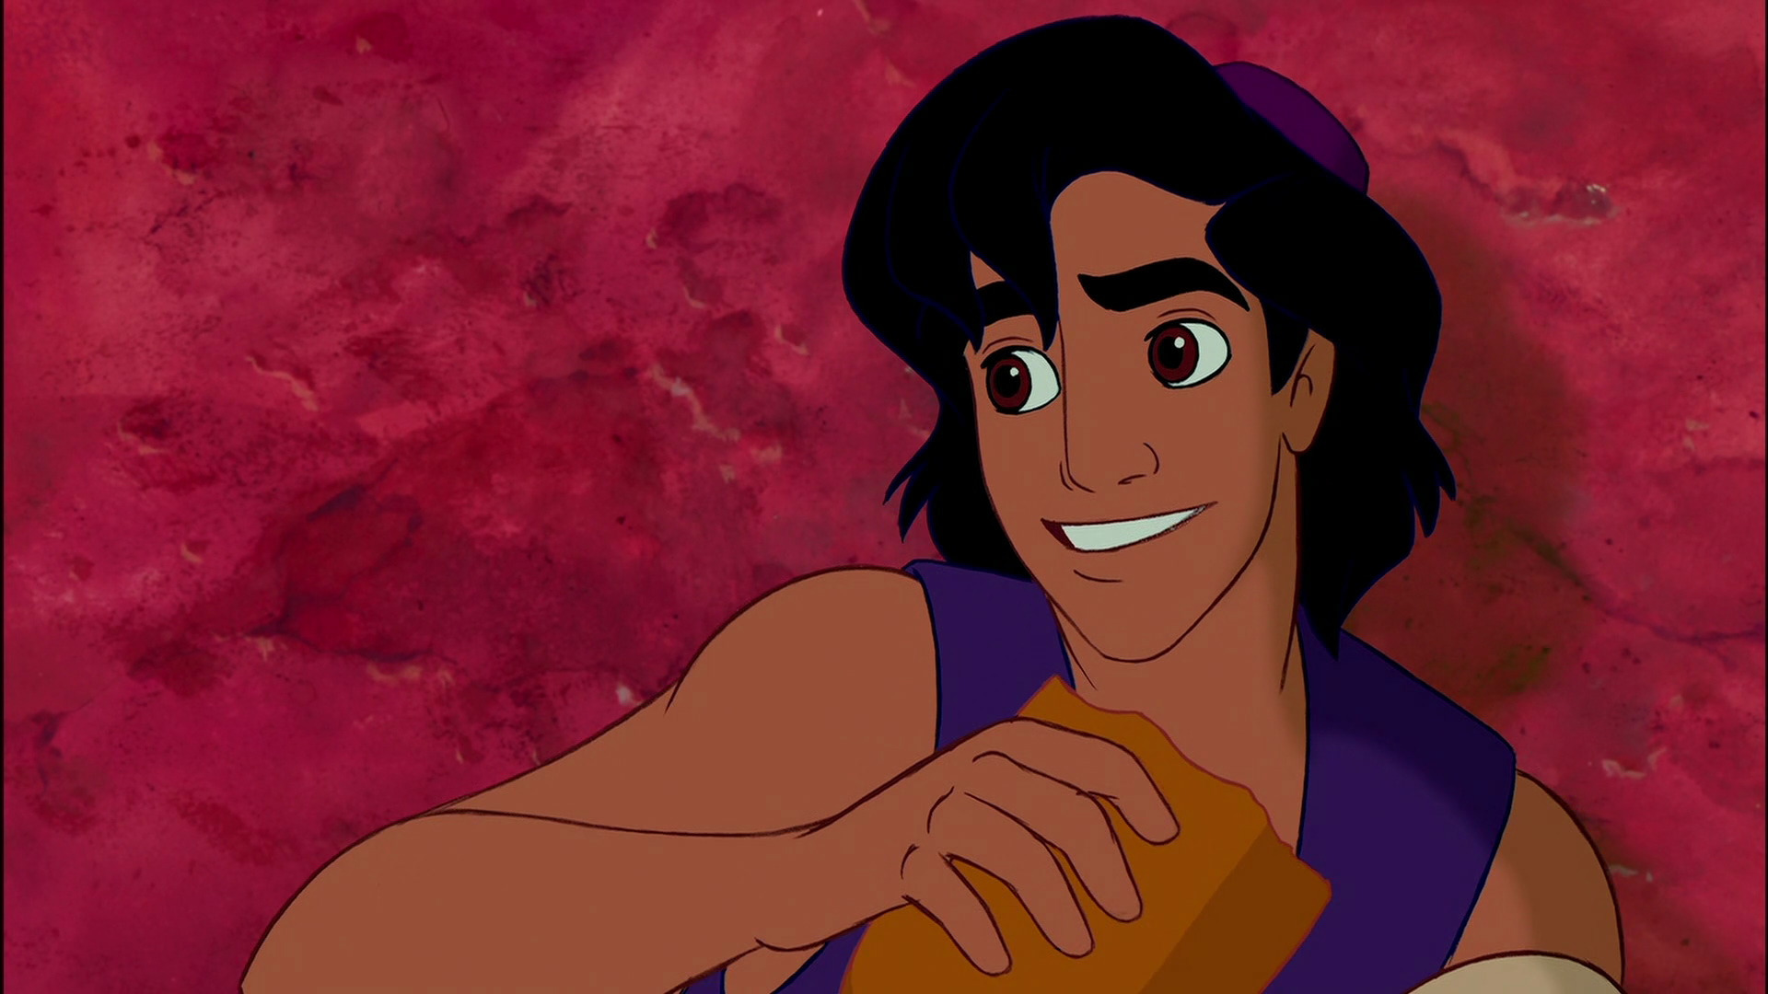
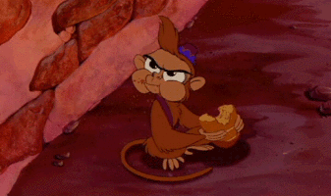
Orphaned at an early age
Mother dies In Medina when he is six
Given to his paternal grandfather Abdul in Mecca
Grandfather dies two years later
Taken in by his paternal uncle Abu
Uncle's family poor, Muhammad sometimes tends sheep

Slide 4
Began leading trade routes for a widow, Khadijah
Impressed with his kind and trustworthy nature, Khadijah asks his hand in marriage
Khadijah is 40, Muhammad 25
They have four daughters, and two sons who died at an early age
Muhammad continued to manage Khadijah's business affairs, and their next years were pleasant and prosperous

Slide 5
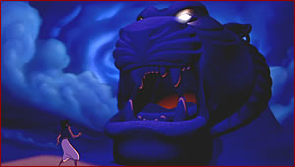
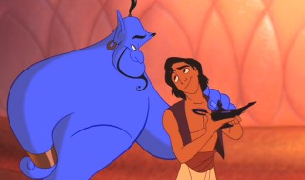
Disillusioned by the materialism and idolatry of Mecca he begins to retreat to a cave
And meets a spirit
Who shares with him a great treasure
Okay! Enough of the Aladdin similarities

Slide 6
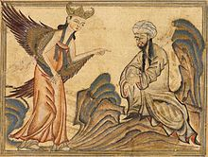
In more seriousness
Muhammad at age forty sees the angel Gabriel
Three years later begins to publicly preach that Allah is the only one God, that complete surrender to Him is the only way, and to give of your wealth to the poor and needy
The revelations he received would later be written and included in the Quran
How was this message received?

Slide 7
Muhammad and his followers were first made fun of (ridiculed)and then persecuted and physically attacked.
Mecca's dominant tribe, banned trade with Muhammad's people.
Toward the end of the decade, Muhammad's wife and uncle both died.
Finally, the leaders of Mecca attempted to assassinate Muhammad.
In 622, Muhammad and his few hundred followers left Mecca and traveled to Medina, the oasis town where his father was buried.
Medina soon became known as the City of the Prophet. Muhammad remained here for the next six years, building the first Muslim community and gradually gathering more and more people to his side.
Notes:
Muhammad and his followers were first belittled and ridiculed, then persecuted and physically attacked for departing from traditional Mecca's tribal ways. For several years, the Quraysh, Mecca's dominant tribe, levied a ban on trade with Muhammad's people, subjecting them to near famine conditions. Toward the end of the decade, Muhammad's wife and uncle both died. Finally, the leaders of Mecca attempted to assassinate Muhammad.
In 622, Muhammad and his few hundred followers left Mecca and traveled to Medina, the oasis town where his father was buried.
Medina soon became known as the City of the Prophet. Muhammad remained here for the next six years, building the first Muslim community and gradually gathering more and more people to his side.

Slide 8
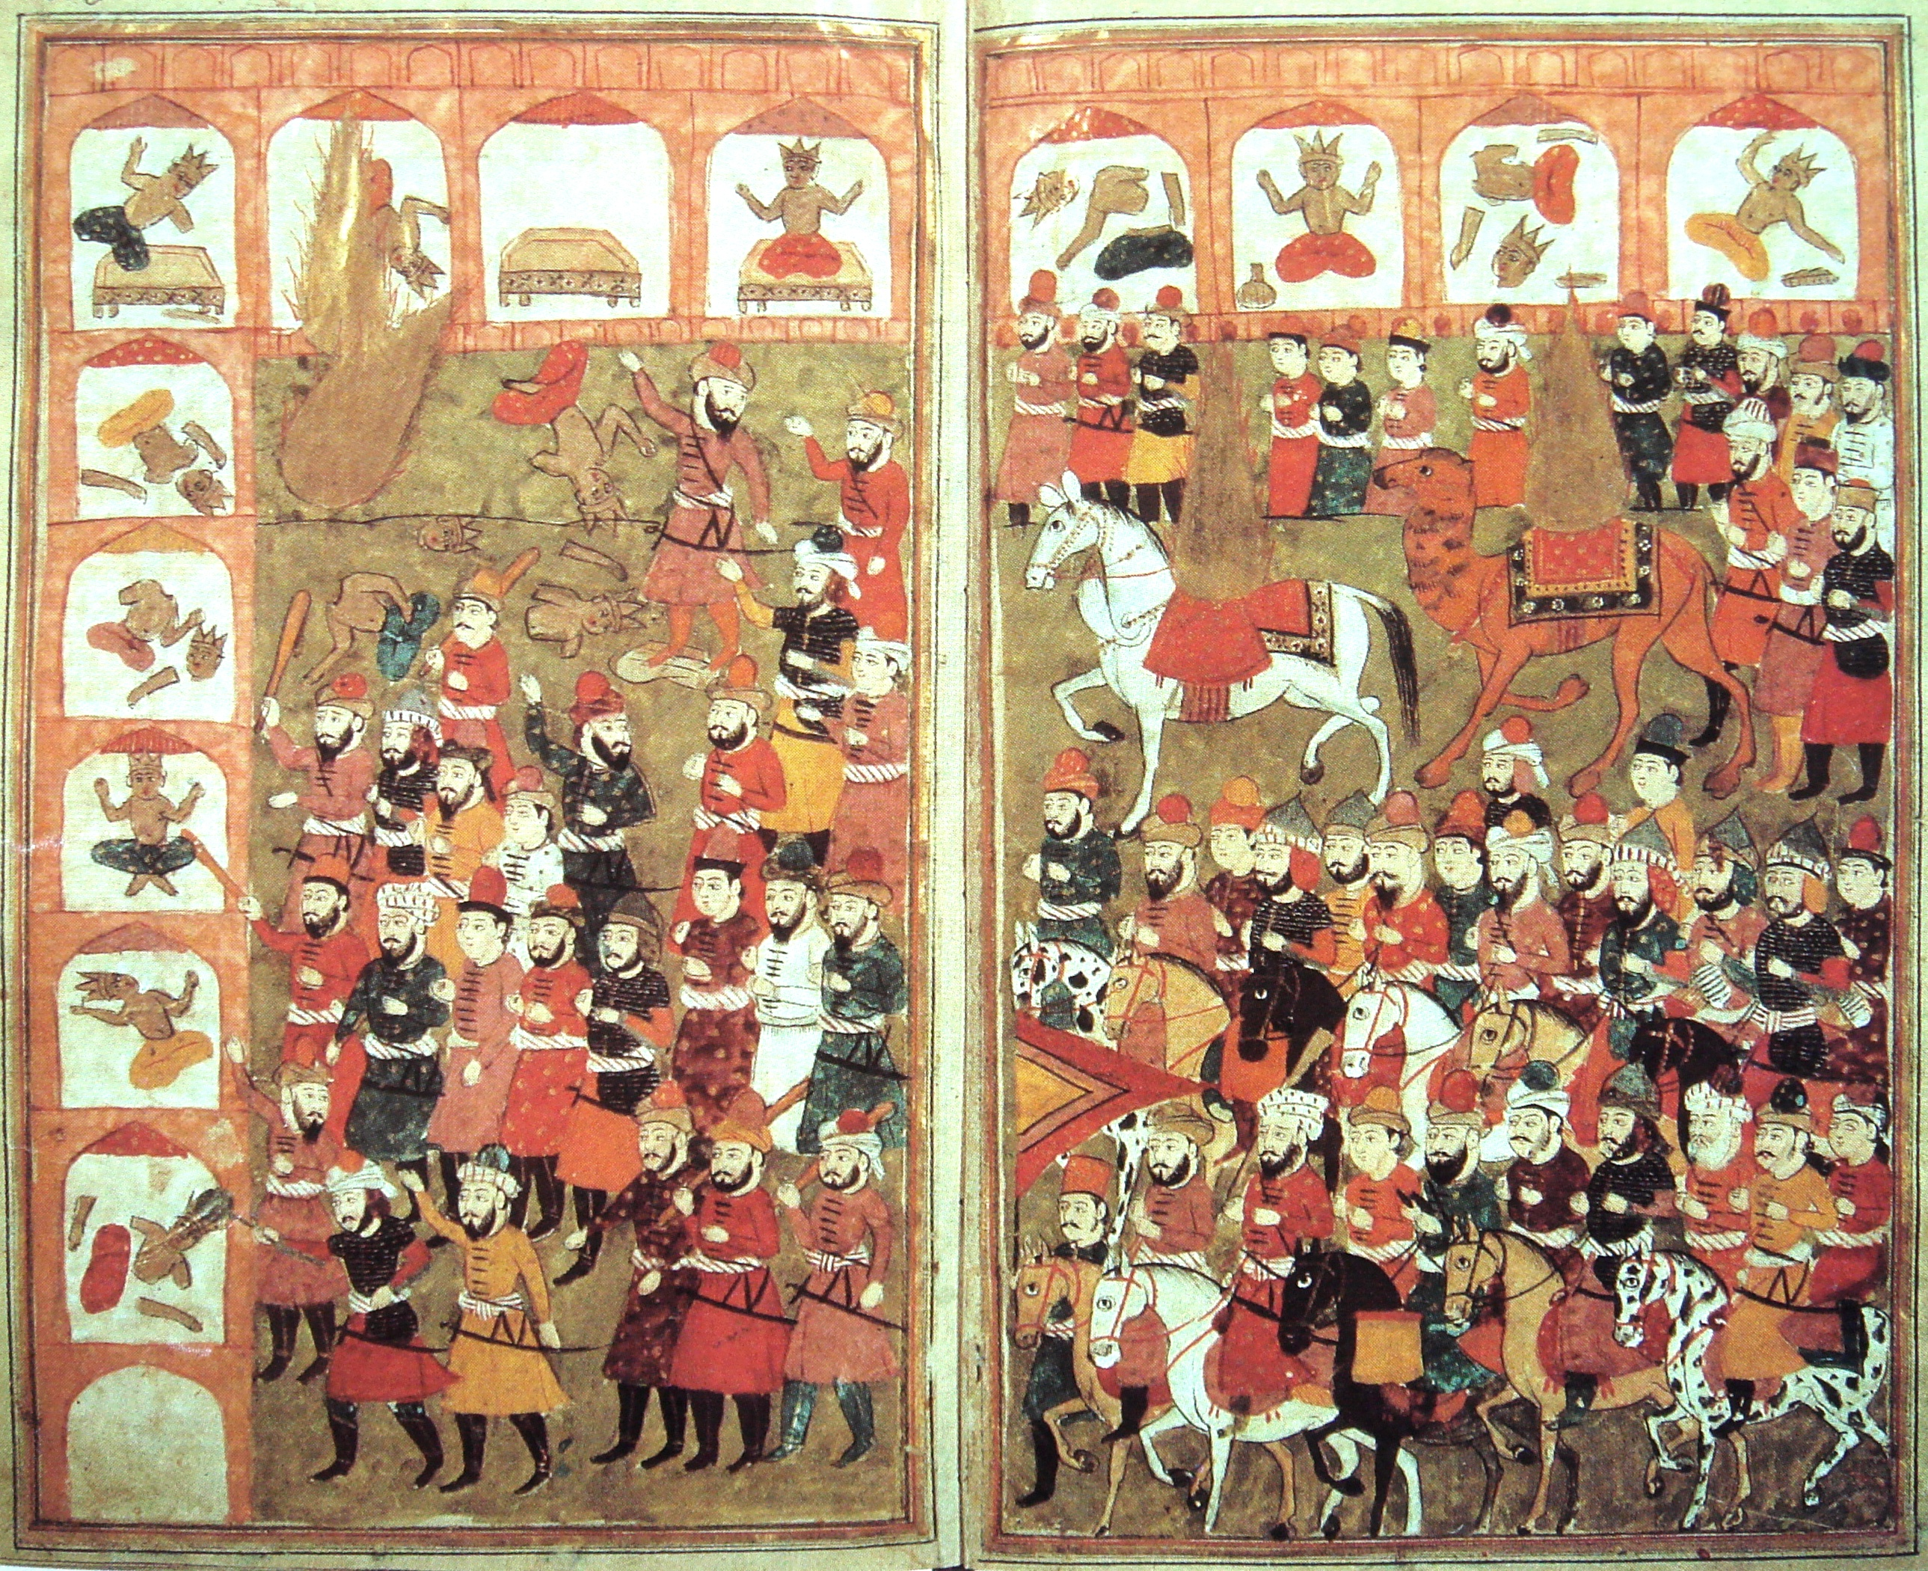
Eight years of fighting, Muhammad gathered an army of 10,000 Muslim converts and marched on the city of Mecca.
He took city with out a fight.
He destroyed the pagan idols in the city and sent his followers out to destroy all remaining pagan temples in Eastern Arabia.
Notes:
After eight years of fighting with the Meccan tribes, Muhammad gathered an army of 10,000 Muslim converts and marched on the city of Mecca.
The attack went largely uncontested and Muhammad took over the city with little bloodshed. He destroyed the pagan idols in the city and sent his followers out to destroy all remaining pagan temples in Eastern Arabia.

Slide 9
Muhammad returned to live in Medina. In the next three years, he consolidated most of the Arabian Peninsula under Islam. In March, 632, he returned to Mecca one last time to perform a pilgrimage, and tens of thousands of Muslims joined him.
After the pilgrimage, he returned to Medina. Three months later on June 8, 632 he died there, after a brief illness. He is buried in the mosque in Medina.

