Slide 1
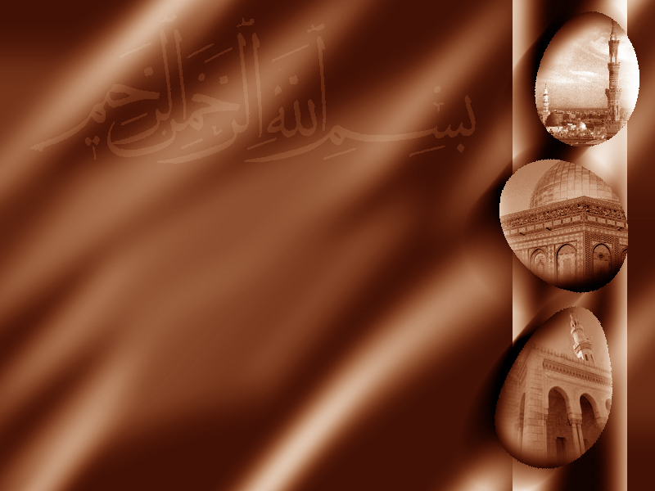
Islamic
Politics

Slide 2
622 AD
two local Arab tribes constantly warring for control of Medina
Muhammad seen as an impartial outsider that could resolve the conflict
Muhammad and his followers moved to Medina and were invited to rule the city
Notes:
Do you remember the significance of the city Medina to Muhammad?
Place of burial for both of his parents
Muhammad seen as someone who cares about city but is neutral.

Slide 3
Medina Charter
Also known as the Constitution of Medina
Officially made him a ruler and recognized him as the prophet of Allah
The Constitution established: the security of the community, religious freedoms, the role of Medina as a sacred place (barring all violence and weapons), the security of women, stable tribal relations within Medina, a tax system for supporting the community in time of conflict, parameters for non-Muslim political alliances, a system for granting protection of individuals, a judicial system for resolving disputes, and also regulated the paying of blood money
Notes:
Charter better word because it wasn't really an agreement but more of a unilateral proclamation by Mohammed
Blood money is the payment between families or tribes for the slaying of an individual in lieu of "eye for an eye"

Slide 4
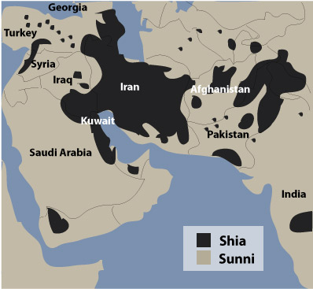
632 AD
Muhammad dies
Shia
Sunni
party of Ali
people of tradition
Only descendants of Muhammad can rule
Any qualified Islamic leader can rule
Imam - can interpret the law
Caliph - codified law
Notes:
Ali is Muhammad's cousin- family can only take over
Sunni-Muhammad's best friend

Slide 5
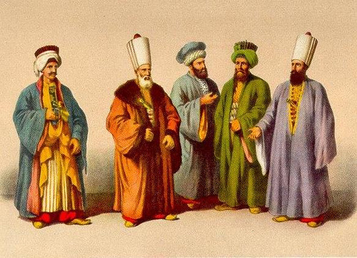
Ulema
Class of Muslims known to be Islamic scholars trained in the whole body of law
Become teachers at Madrasahs (place of learning), imams at mosques, qadis or Sharia court judges
Notes:
Muslims have a love of education.
Created a societal class of scholars

Slide 6
Mix of Theocracy, Democracy, Republic
Theocracy- law based on religious text of Quran
Democracy - elected ruler
Republic- codified Sharia law represented by the Ulema
Sharia (Islamic law) deals with many topics addressed by secular law, including crime, politics, and economics, as well as personal matters such as sexual intercourse, hygiene, diet, prayer, everyday etiquette and fasting.
Notes:
Political structure is based on three types of government

Slide 7
Society
Caliph
Ulema
Families - Fathers

