Slide 1
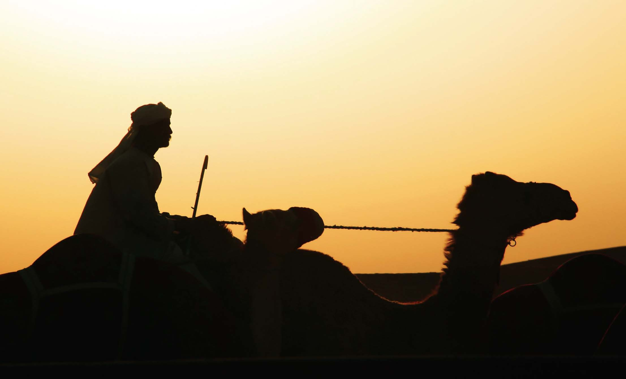
Islam

Slide 2
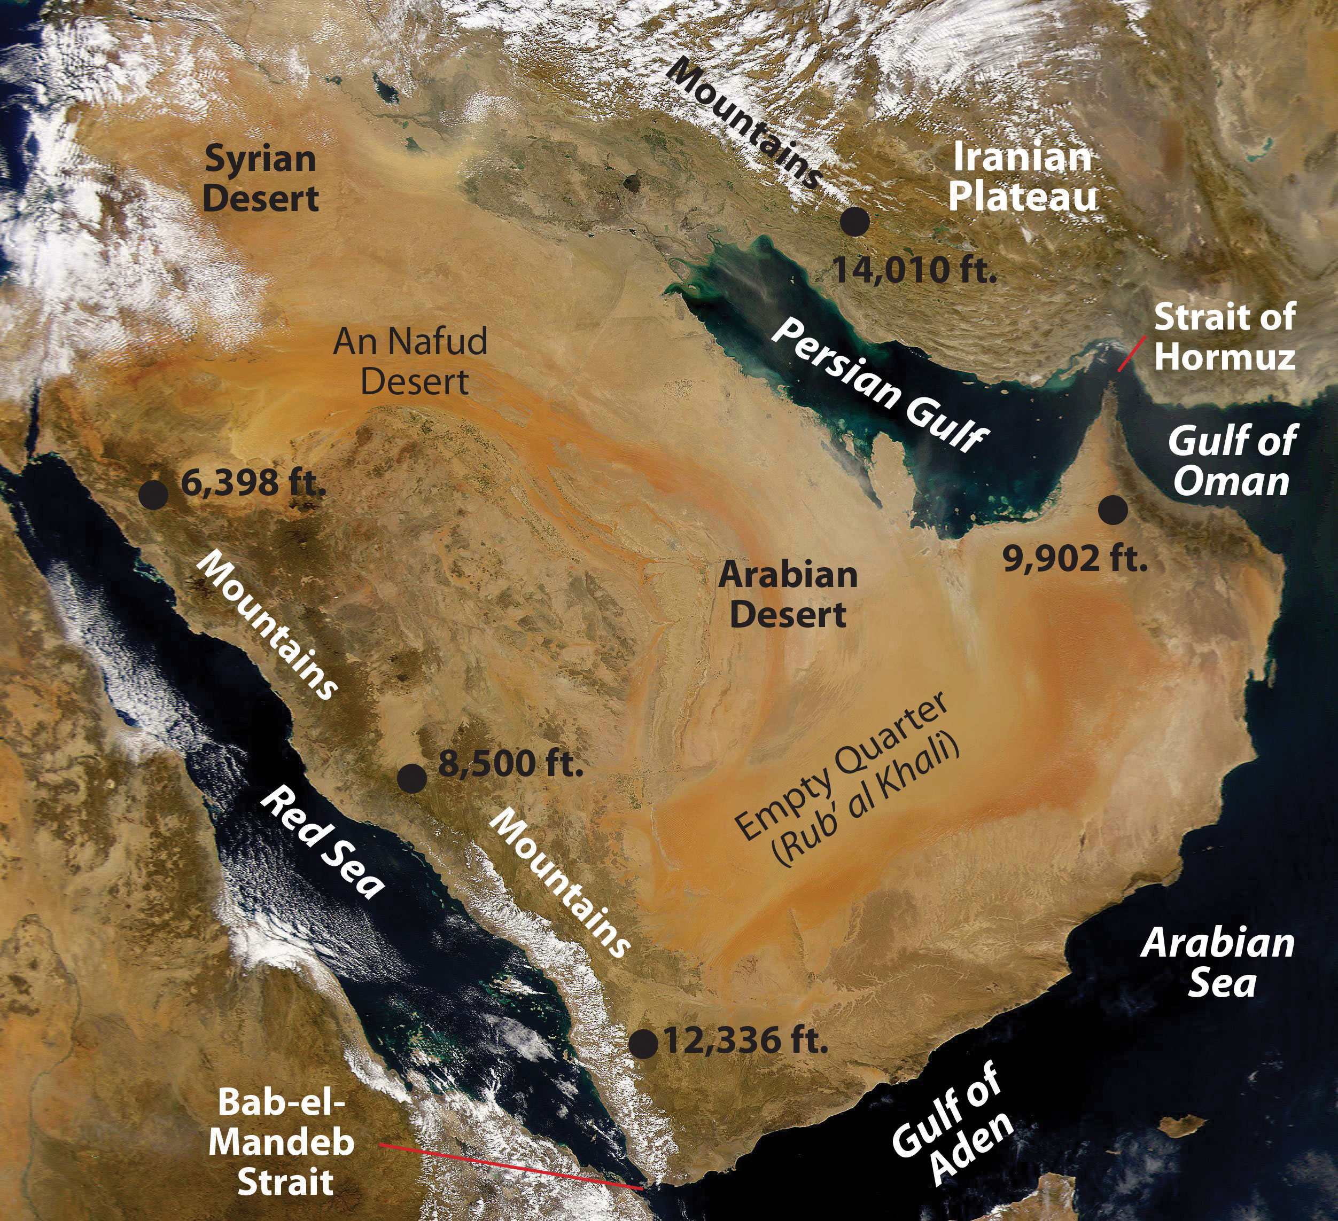
Notes:
What do you see?
What is a peninsula?
What is a strait?
Is it all desert?

Slide 3
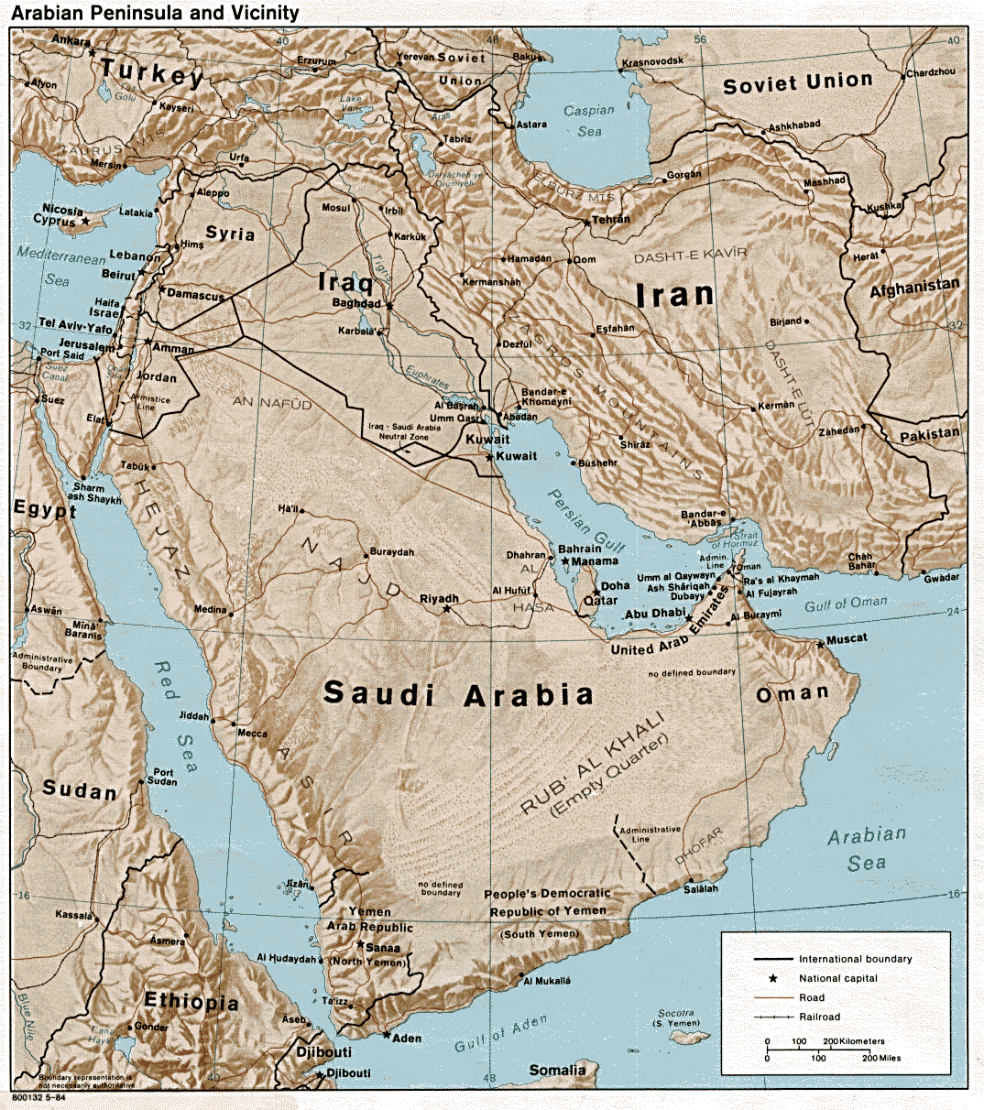
90% Desert
Hot & Dry
No permanent lakes or rivers
Empty Quarter is largest sand desert in world
Dunes
800 Ft High
100s miles long
Ringed with mountains
Amazing Coasts
Unique Wildlife
Notes:
Desert north/south
Cities are built where there isn't desert
Figured out how to cross desert.

Slide 4
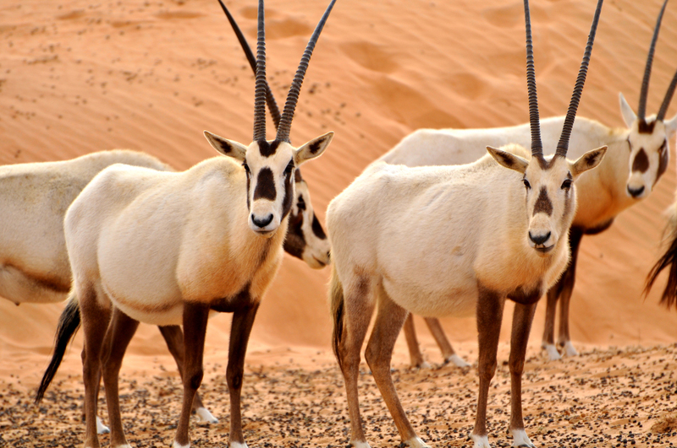
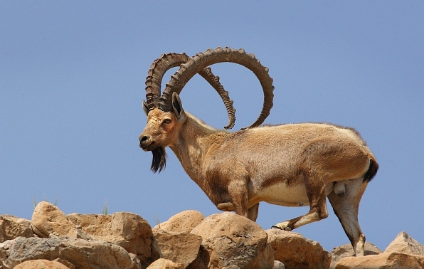
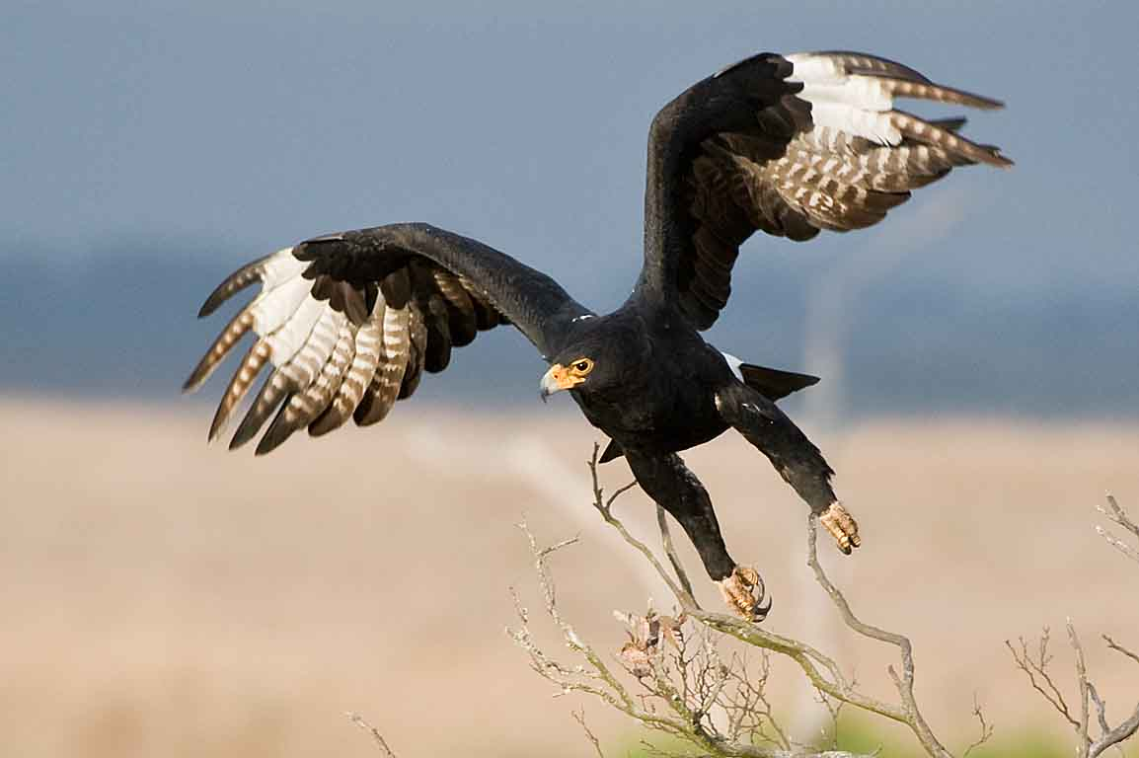
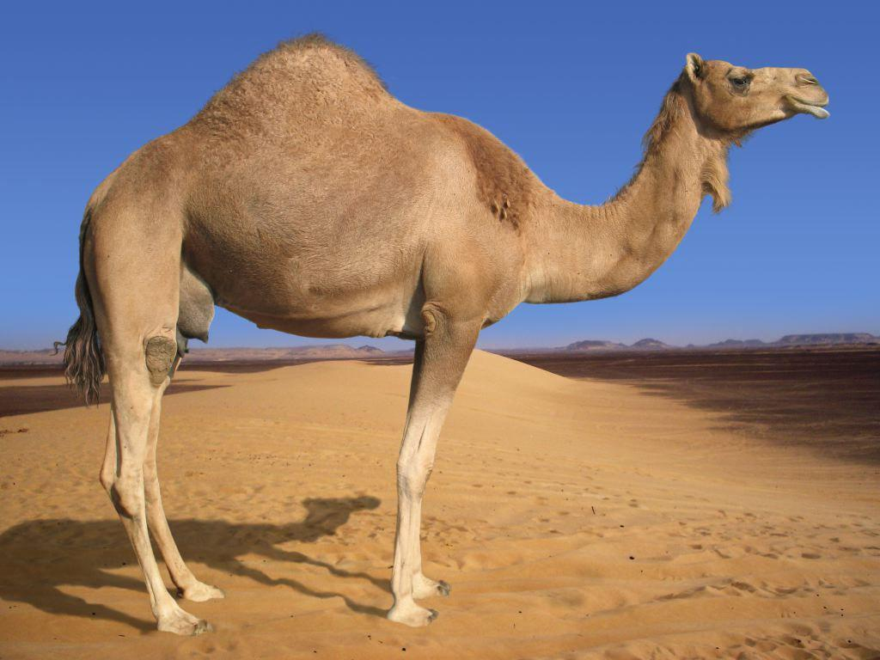
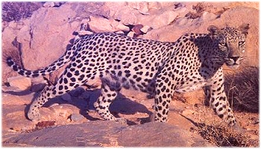
Oryx
Ibex
Verreaux's Eagle
Camel
Arabian Leopard
Notes:
oryx -less than 200 in the world. As hearty as camels. White?
Ibex -ram
Camel- what do you think is in the hump? Fat
-long legs, split toes and big feet, translucent eye lids,
Arabian leopard
Black eagle- coastal mountains

Slide 5
BBC's Wild Arabia

Slide 6
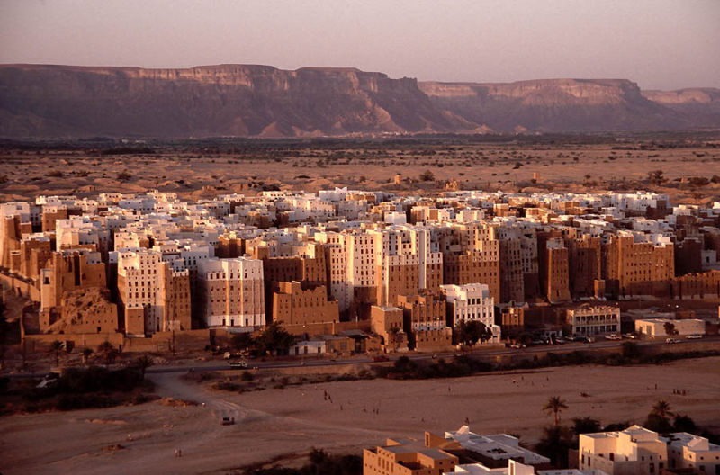
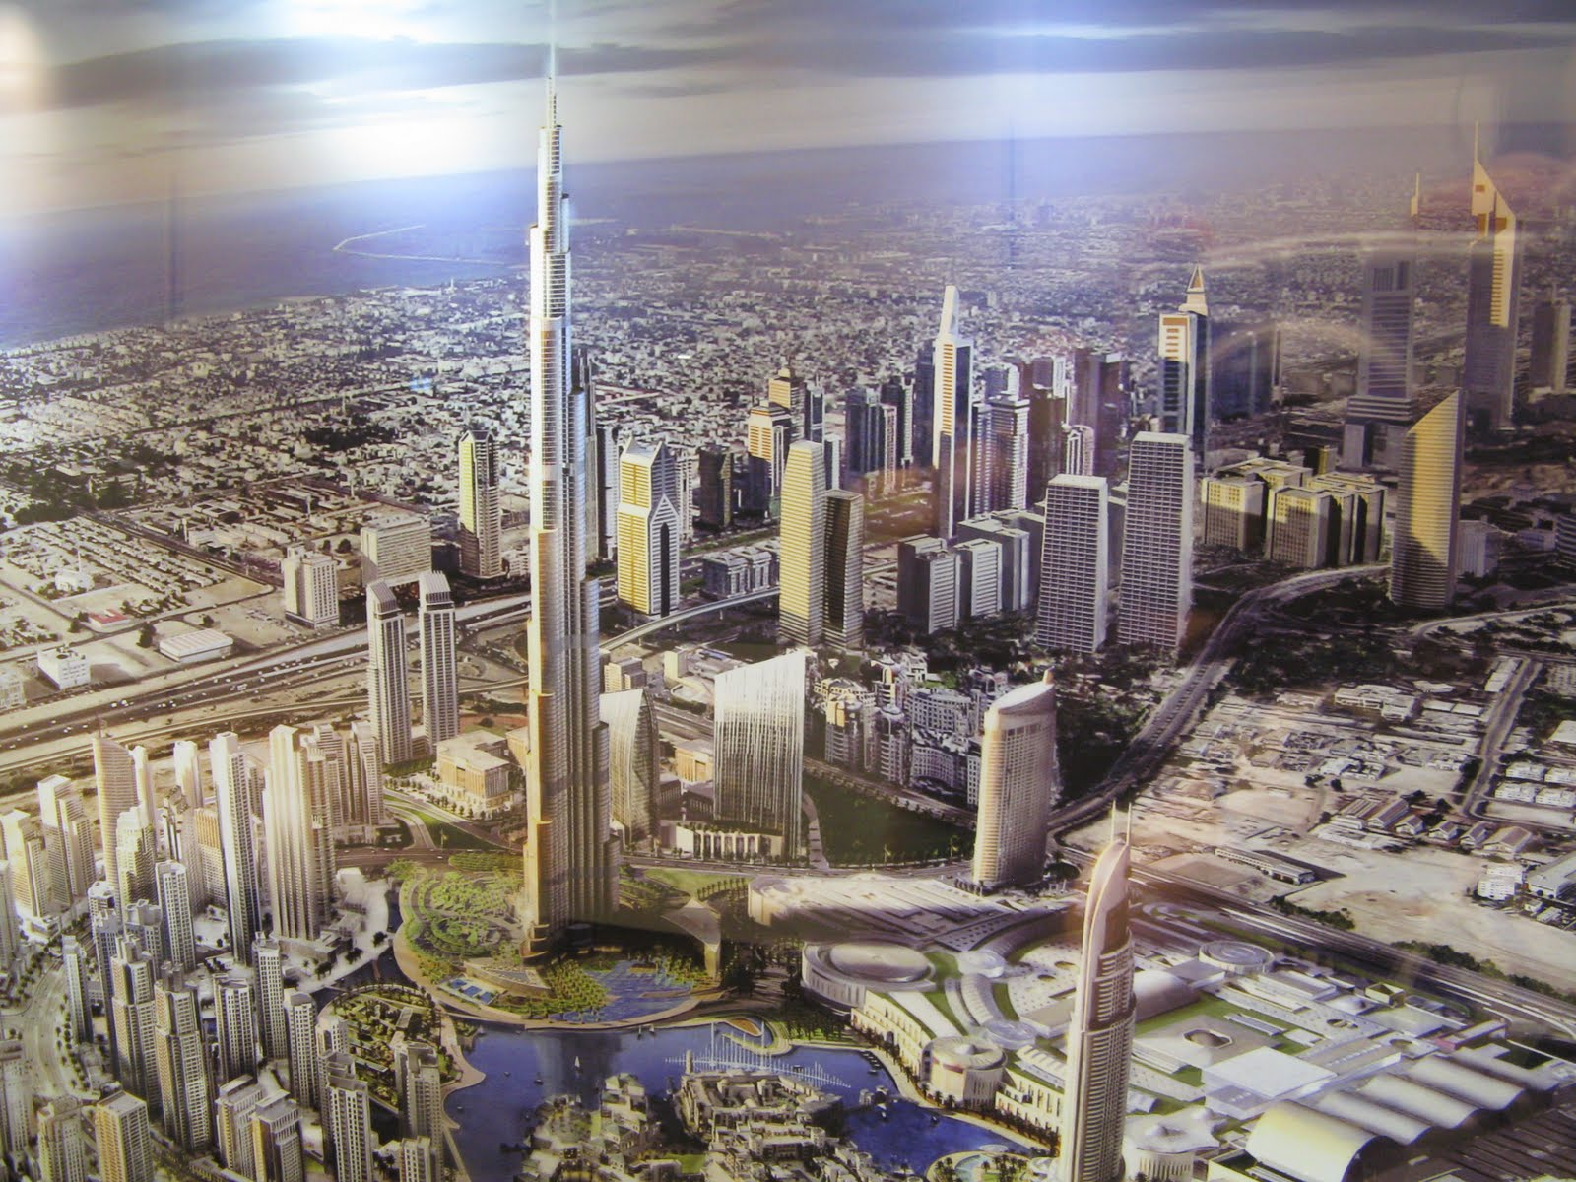
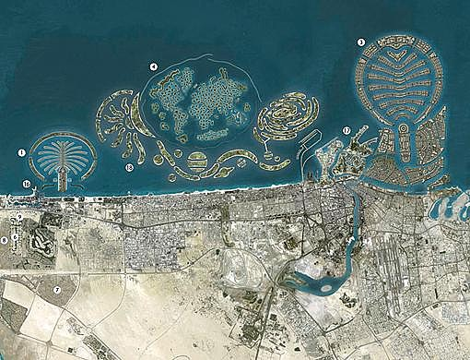
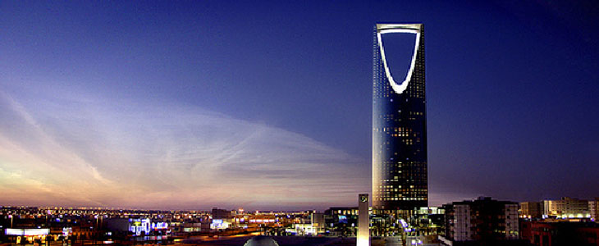
Riyadh
Yemen
Dubai
Notes:
What do you think of when you think of desert cities?
Ours is Las Vegas. Why are the ceilings white?
Reeyawd
Dubai richest city

Slide 7
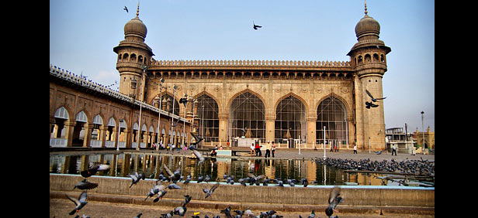
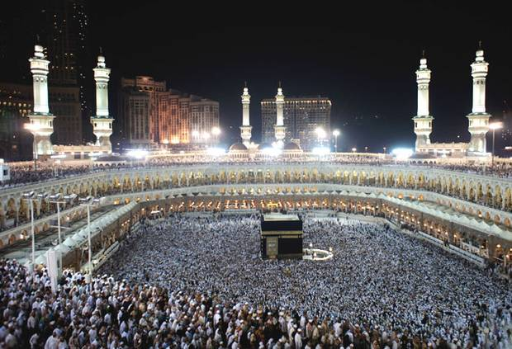
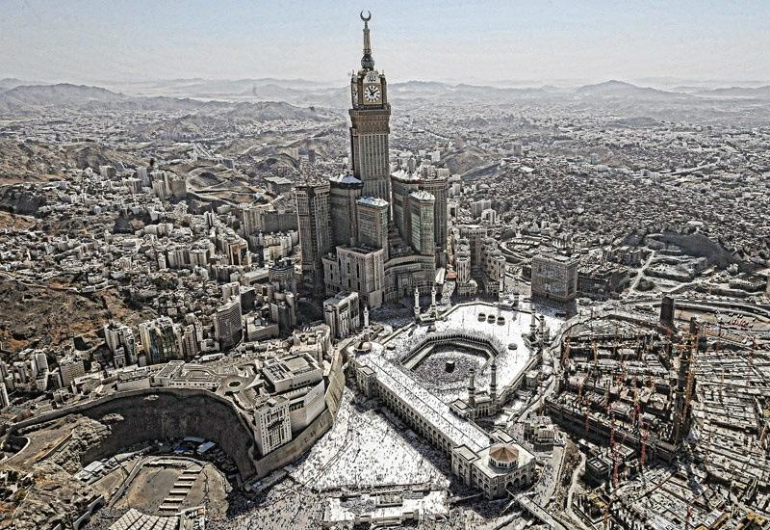
Mosque
Kaaba
Clock Tower
Notes:
Mecca -Kabba is the holy shrine
Old medieval mosques
Largest clock tower in the world

Slide 8
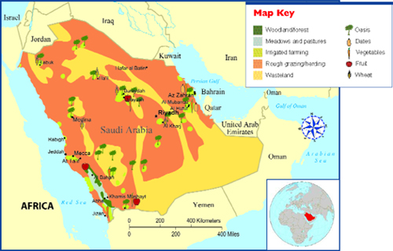
Geography effects Economy
Notes:
Yellow:The desert is so harsh they labeled it wasteland
Red: harsh terrain and environment; potential for hardy grazing and herding
Dark green: oasis - underground water
Light green: they had efficient use of water available; irrigated farming
Thanks to farming they have ability to harvest some fruits vegetables and wheat

Slide 9
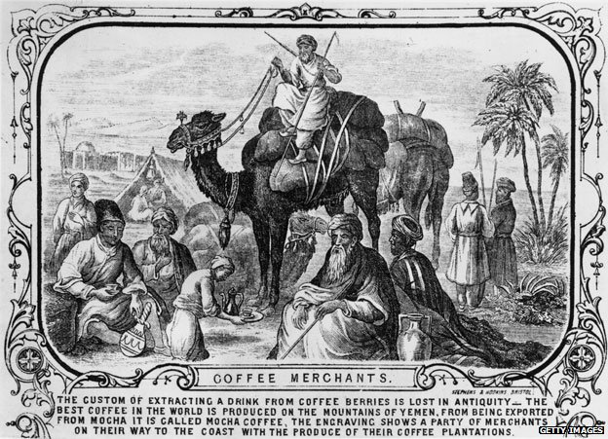
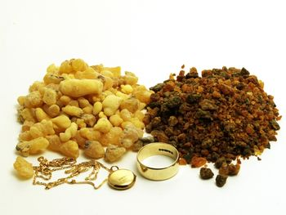
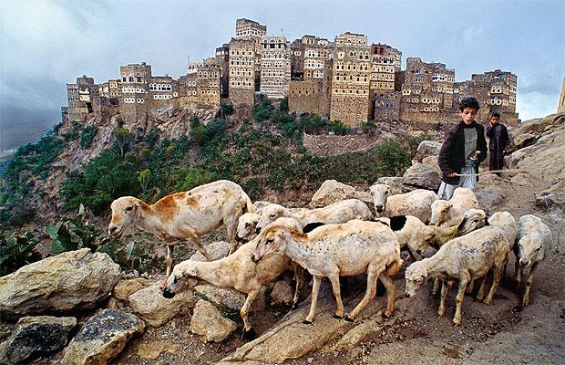
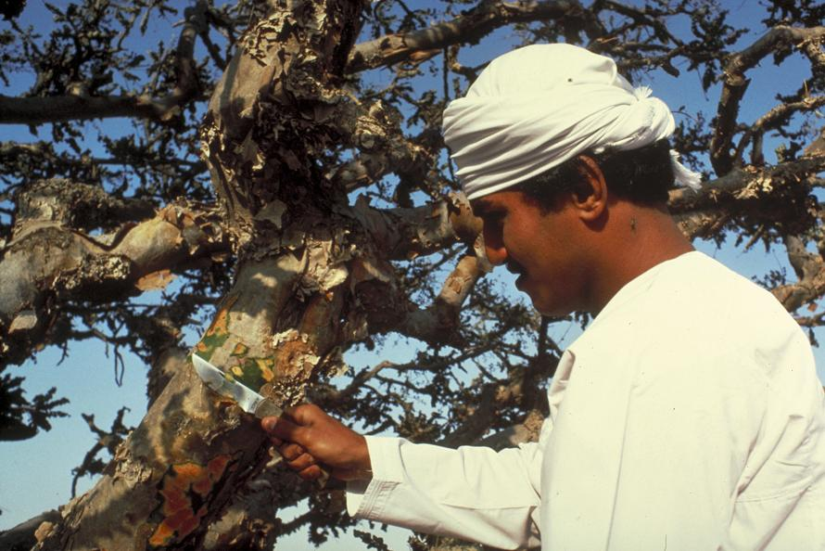
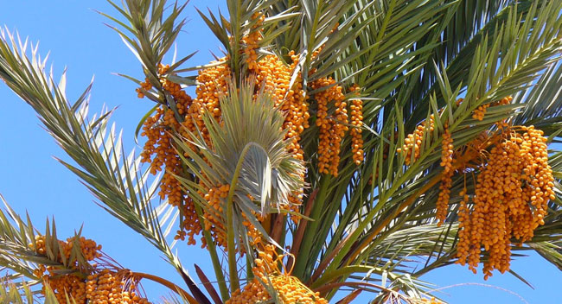
Coffee
Frankincense
Dates
Goats
Notes:
Coffee: first known use; Arabic coffee trees on the Yemen coast
Dates: hardy fruit; easily dried, good travel food, high in sugar, good energy
Goats: hardier than sheep, produce meat, milk, cheese
Frankincense: sap from tree, mentioned in Bible; healing properties, in old worth as much as gold, still sought after today, 5ml cost $60

Slide 10
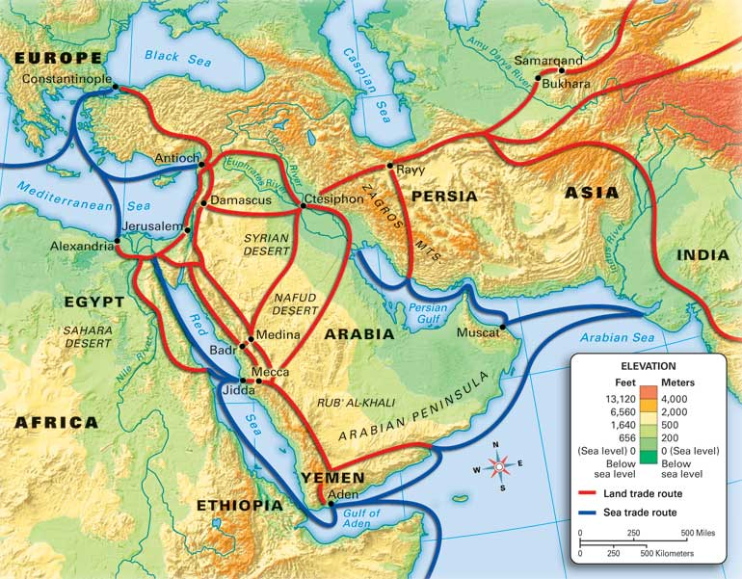
The Crossroads
Notes:
In the middle of the Chinese empires, Indian, Persian, to East
And Egyptian, Roman, European nations to West

Slide 11
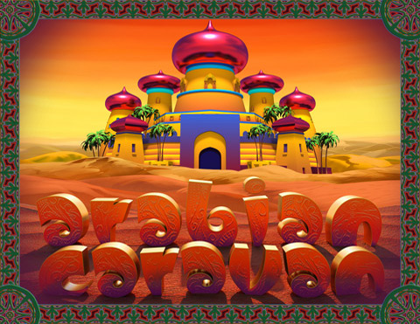
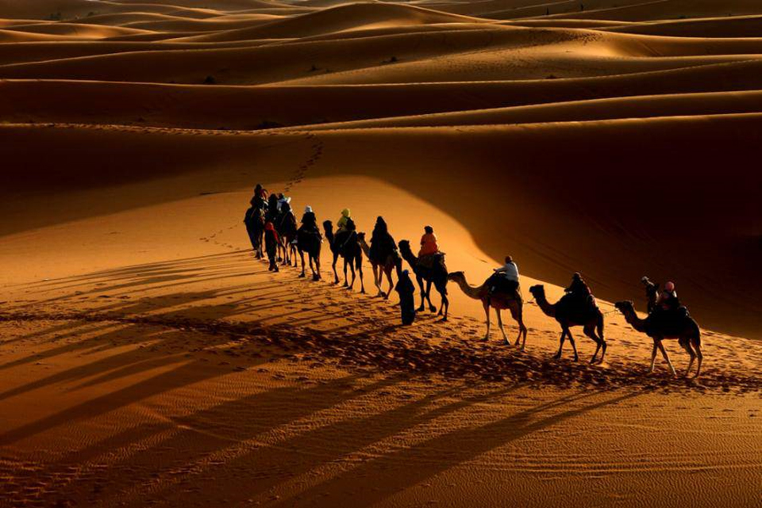
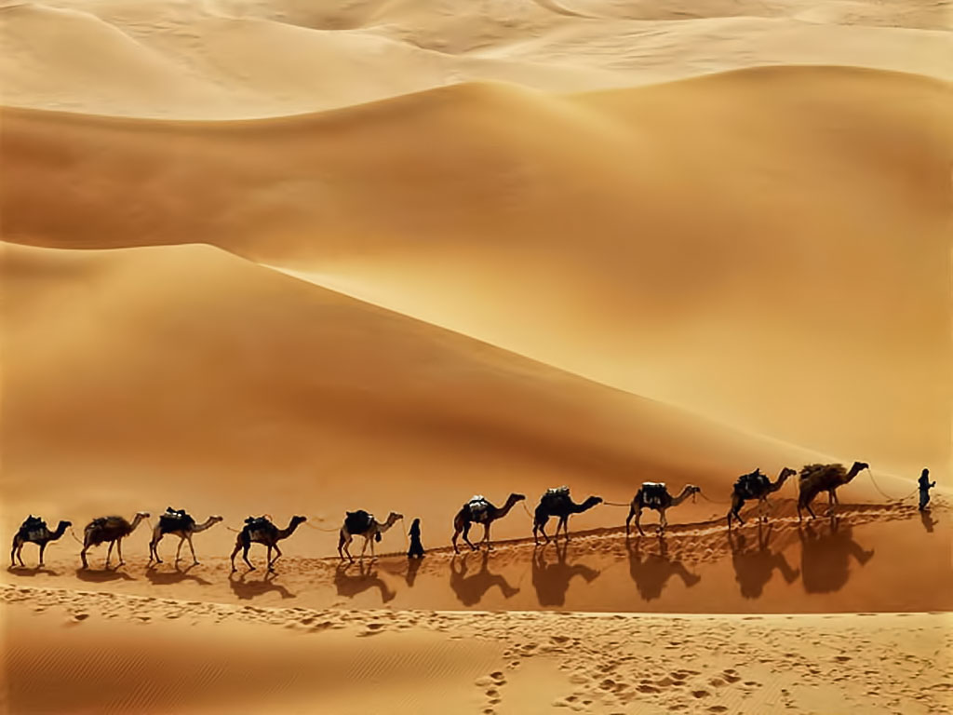
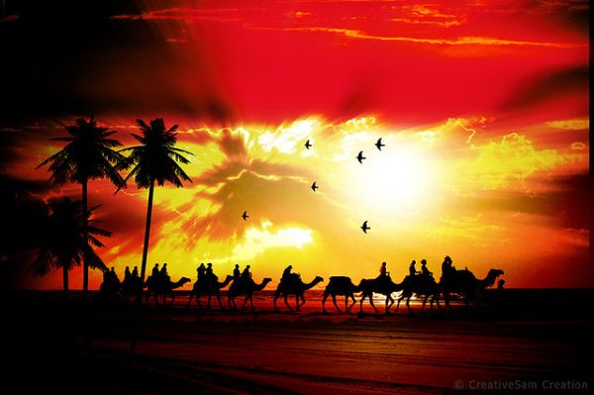
Notes:
The popular profession of ancient Islam was a merchant.
Not only did they transfer and trade goods but they knowledge To make their circumstances better.

