Slide 1
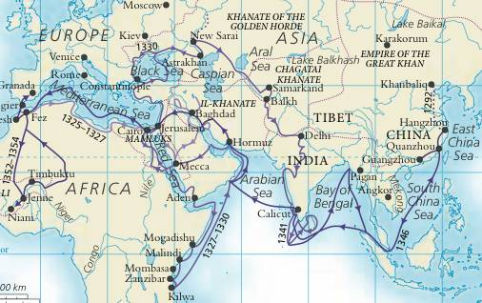
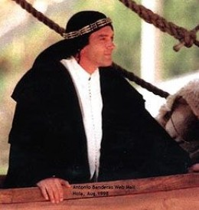
Islamic Achievements
Islamic culture fostered a love of knowledge that led to the world's first Pinterest
13th Warrior
Used the Chinese invention of paper to transcribe and record collections of current research and knowledge
Encouraged travel to distant countries and study of different cultures
Ibn Battutah's 75,000 miles
Ahmad ibn Fadlan
Large empire that spans three continents that holds a knowledge trade show every year by returning to Mecca to share their "pins"

Slide 2
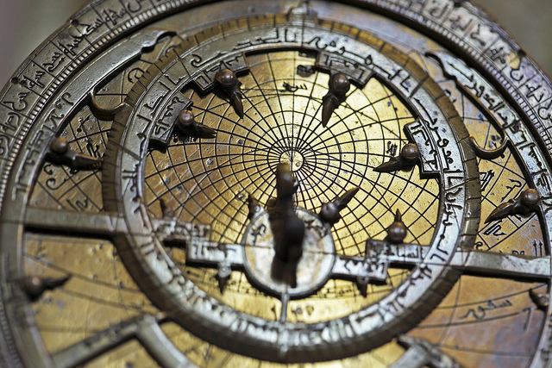
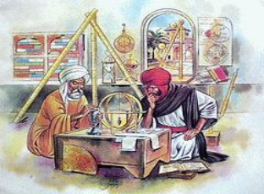
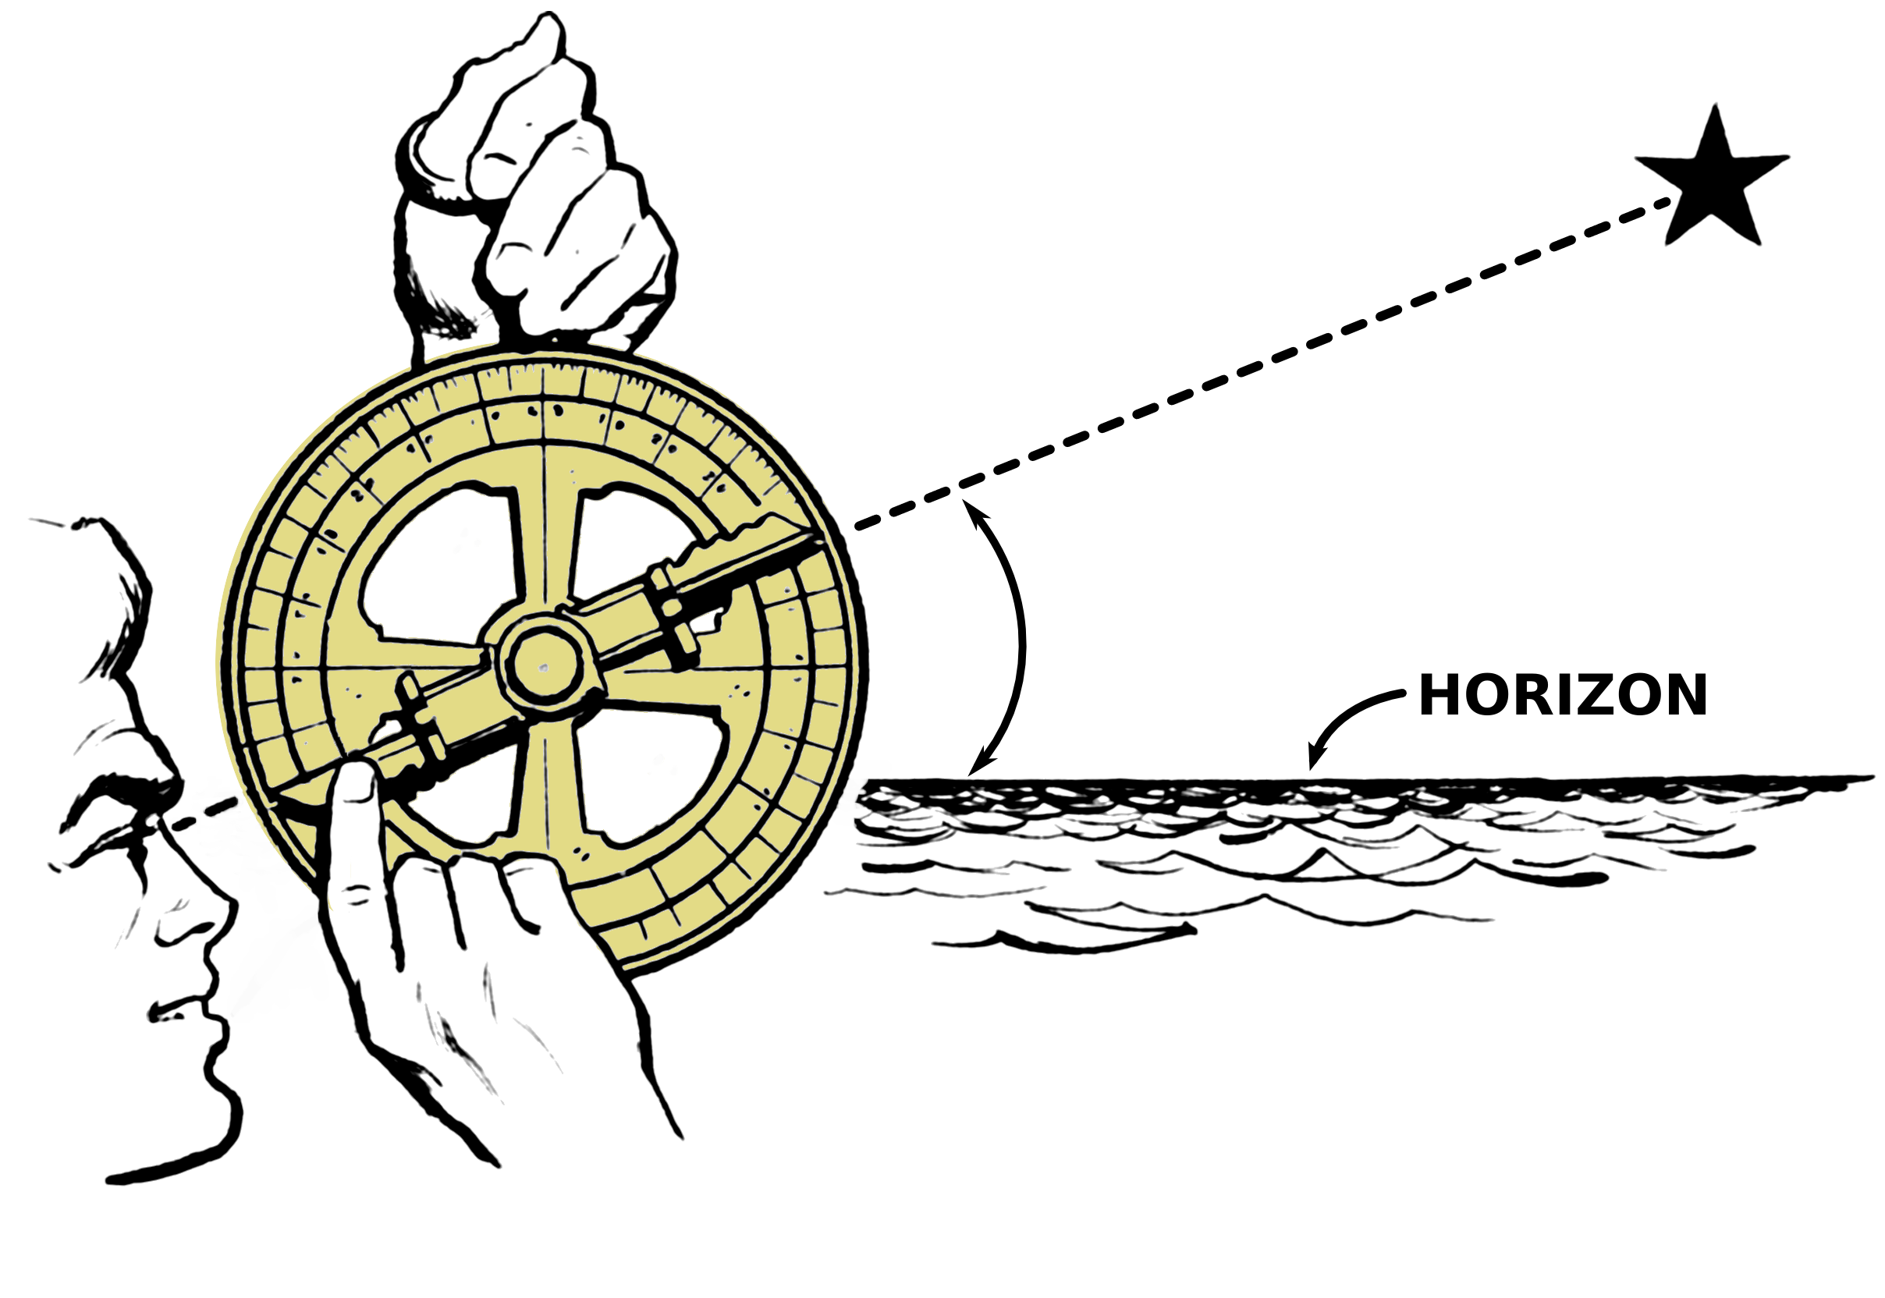
Astronomy
Astrolabe
Invented by Greeks
Muslims added angular scales and circles
Had 1000 uses in astronomy, astrology, navigation, surveying, timekeeping
Helped in finding the direction to Mecca and prayer times

Slide 3
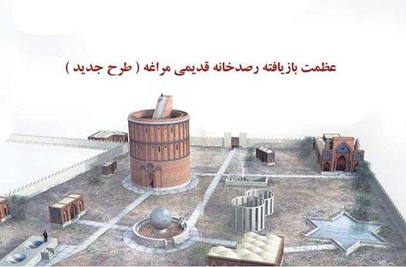
Maragheh Observatory
Largest observatory of its day, built on a mountain top to better see the stars
Astronomers from Arabia, Africa, China came here to study, over 100 students at its peak
Included a library of over 40,000 books
Discoveries included:
The earth rotated on its axis
Precise measurements of the orbits of each planet
Development of an accurate chart of the moons orbit around the earth
Notes:
Watch BBC video on Astronomy 2:54-8:55

Slide 4
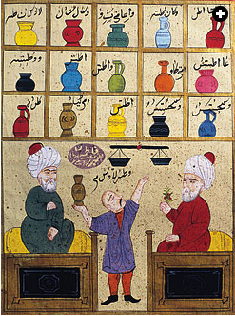
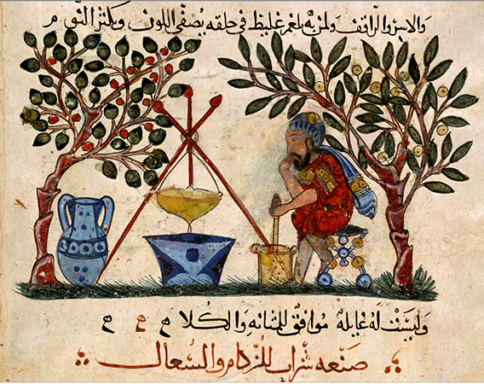
Medicine
Made encyclopedias of drugs and descriptions of their effects
Started the first pharmacy school to teach people how to make medicines

Slide 5
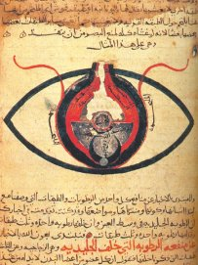
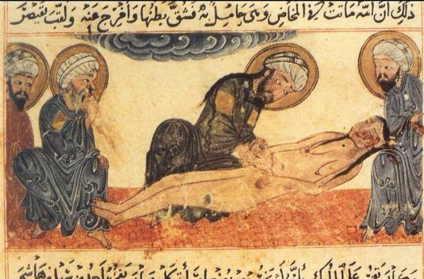
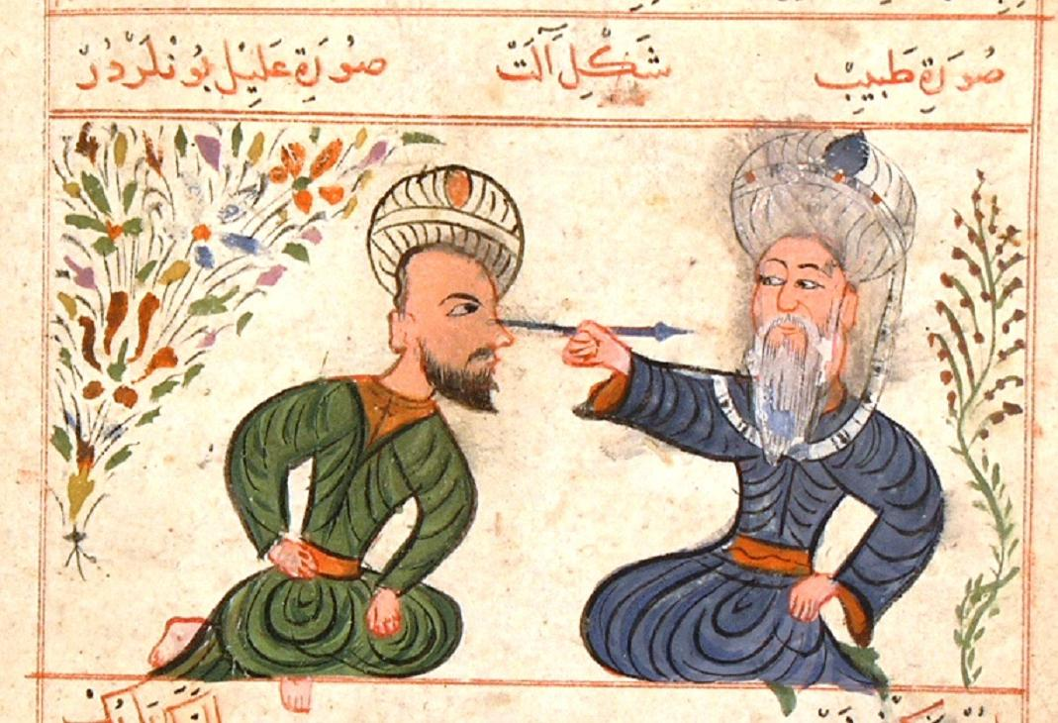
Hospitals
First Muslim hospital built in Baghdad
Included separate wards to treat patients with different diseases, including mental illnesses
Treated all citizens often free of charge
Developed the use of anesthetics
Discovered how to remove cataracts
First to illustrate and describe a C-section
Notes:
Watch BBC video 45:20-52:40
Skip massage part and go to old man making soap

Slide 6
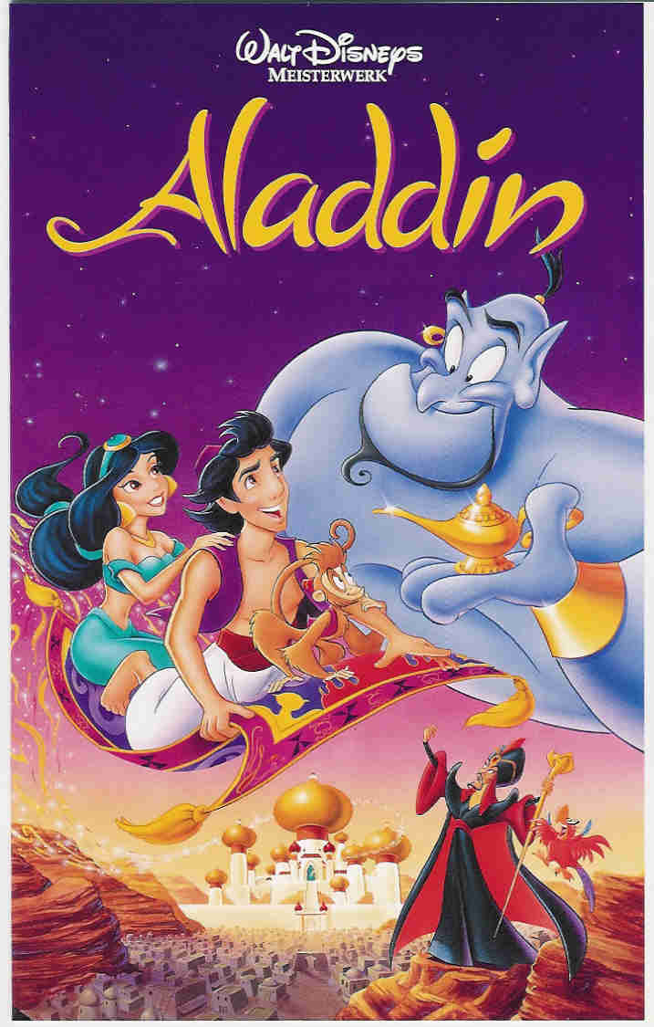
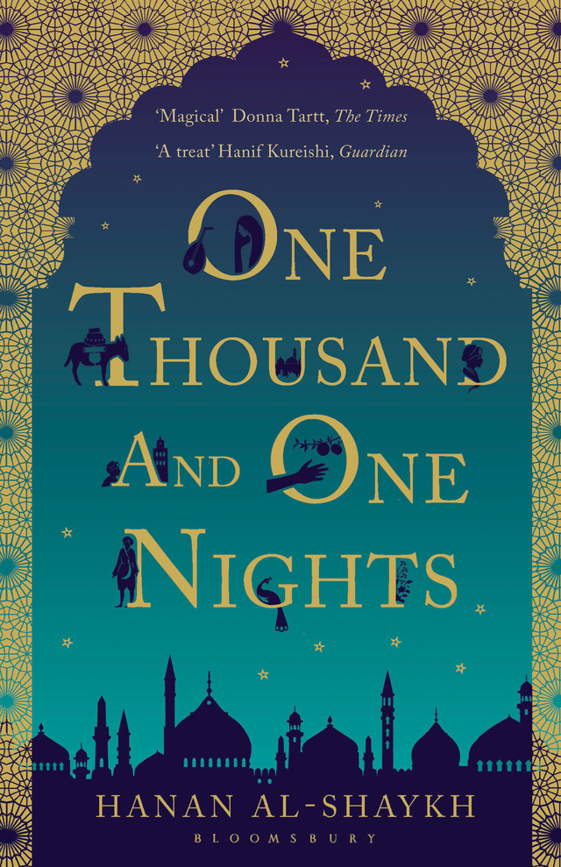
Bookmaking & Literature
Muhammad Ar-Razi wrote over 200 books on medicine, alchemy, history, and philosophy.
Ibn Sina wrote over 450 books including the Book of Healing which described thousands of diseases and their treatments and was used in European universities until only a few hundred years ago.
Many of Euclid's and Pythagoras' (Greek mathematicians) writings survived only because Muslims made translations of them
Enjoyed short stories: The Thousand and One Nights, Sinbad the Sailor, Aladdin, Ali Baba and the Forty Thieves
Notes:
Muhammad Ar-Razi was a Persian doctor who lived from 865 to 925. In his lifetime he wrote over 200 books on a range of subjects from medicine, alchemy, history, and philosophy.
Ar-Razi described the disease of Smallpox which helped doctors to identify the disease more quickly and to treat it more effectively.
Ar-Razi also wrote a book for people to use at home to treat minor injuries or illnesses. In it he included recipes for medicines as well as advice on diets and
exercise.
Ar-Razi also wrote about medical ethics – or the rules
that doctors should follow when treating patients. In it he wrote that "The doctor's aim is to do good, even to our Enemies “
WatchBBC video 23:38-24:47

Slide 7
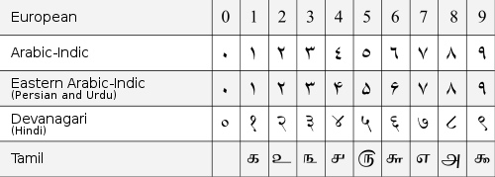
In the 800s Muslim mathematicians combined the Indian number system, including the use of zero, with the Greek science of mathematics.
Mathematics
The Muslim mathematician al-Khwarizmi then used these new ideas to write a math textbook that he called al-jabr, or “algebra.”
Also made advances in geometry and trigonometry

Slide 8
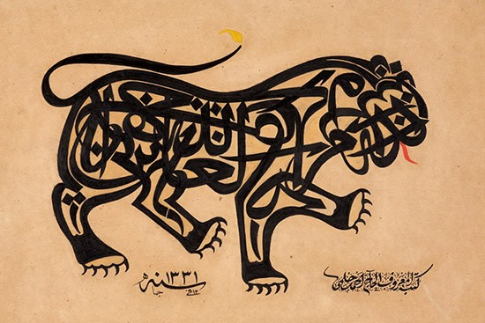
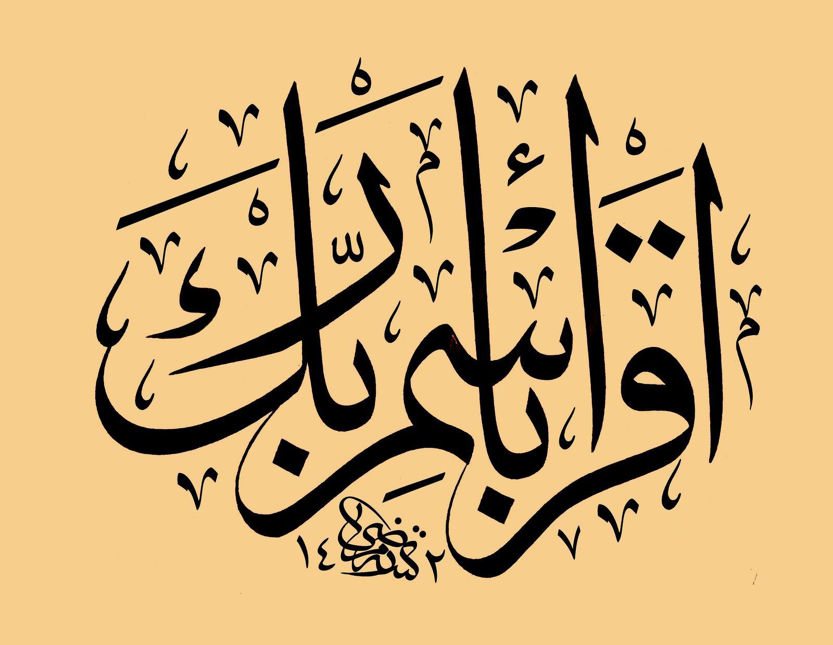
Art
Many Muslims think that only God can create humans and animals or images of them
Although the Quran does not prohibit depictions of humans or animals it does warn against idolatry
As a result Muslim art focused on decorative writing called calligraphy and geometric patterns

Slide 9
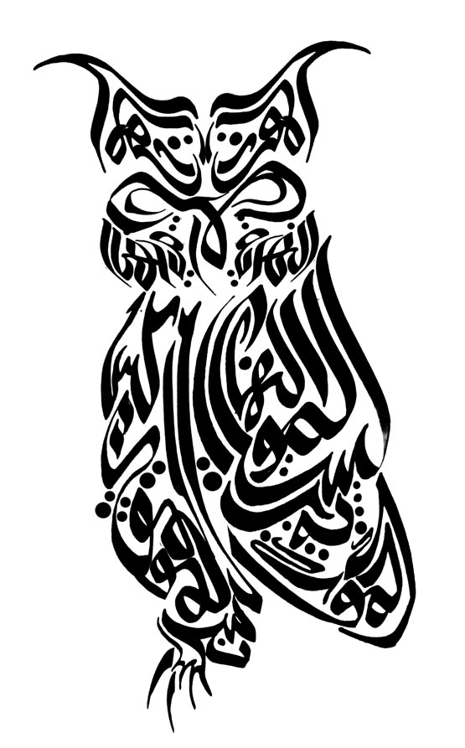
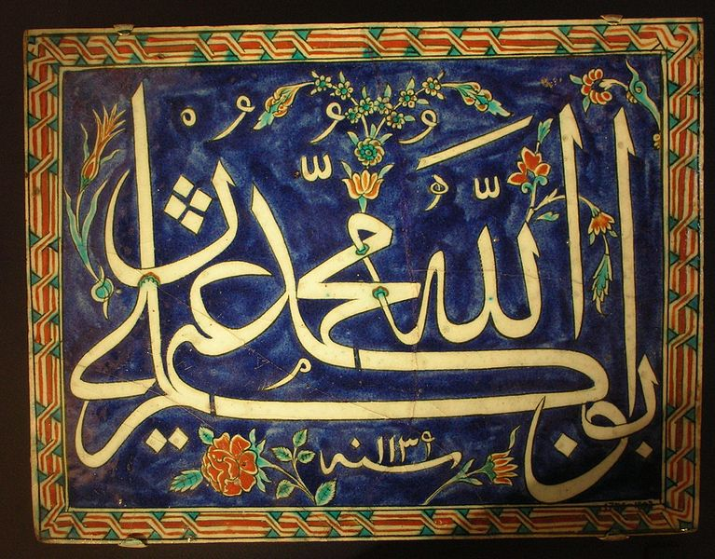
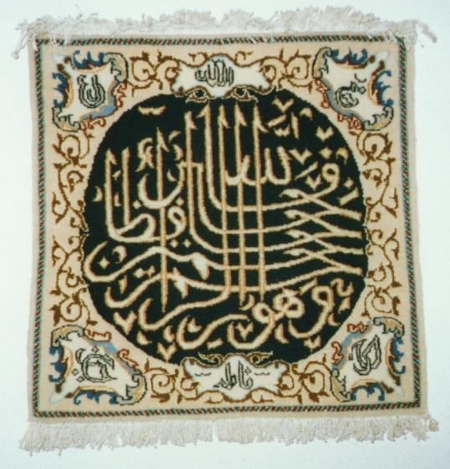
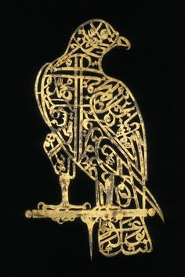
Calligraphy
was painted on tiles,
woven into carpets and clothing
hammered into metal
and often shaped to look like shapes or images

Slide 10
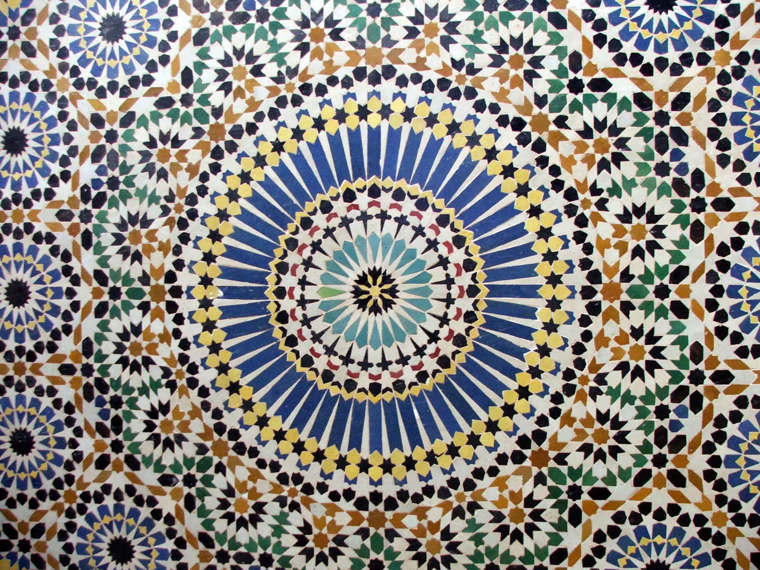
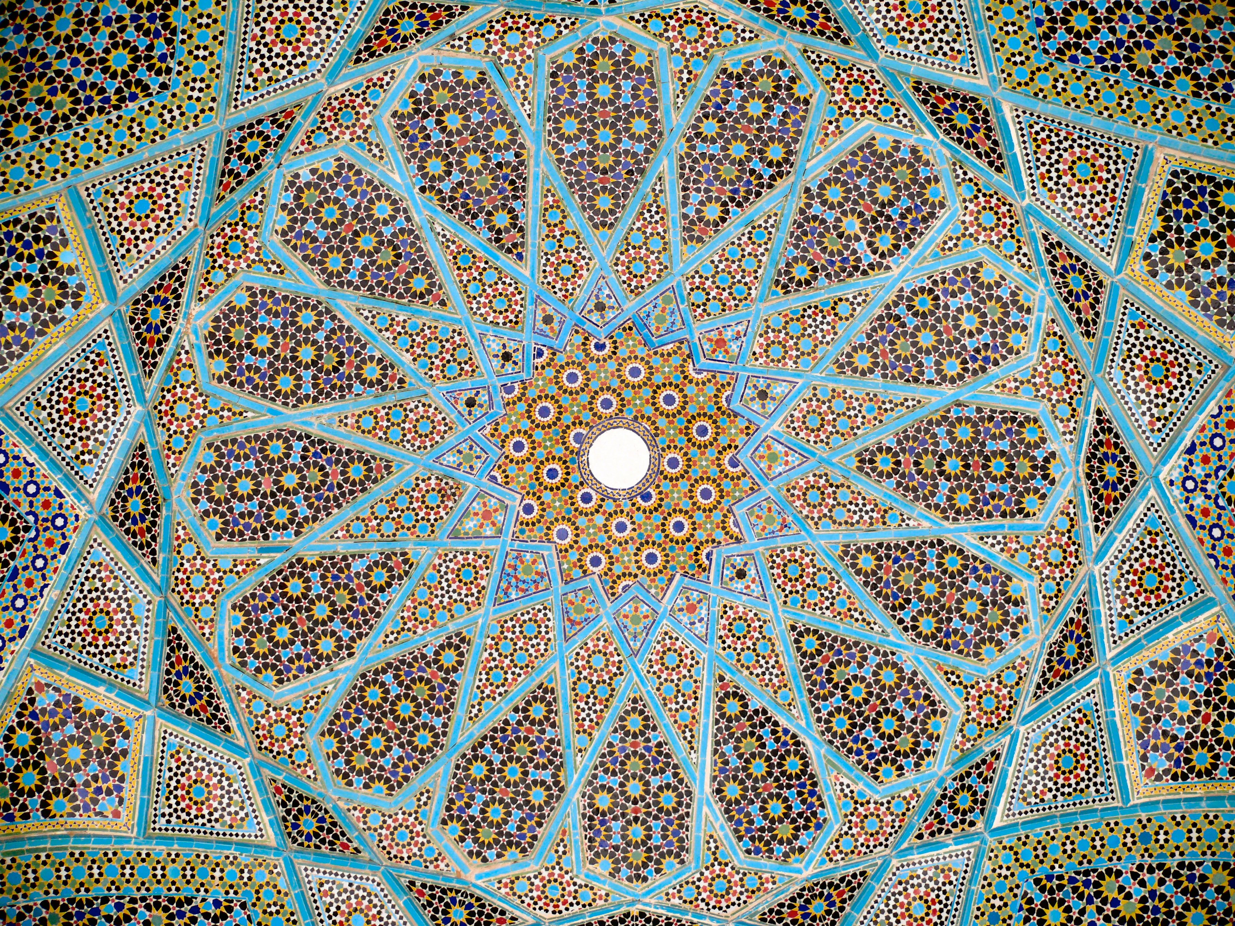
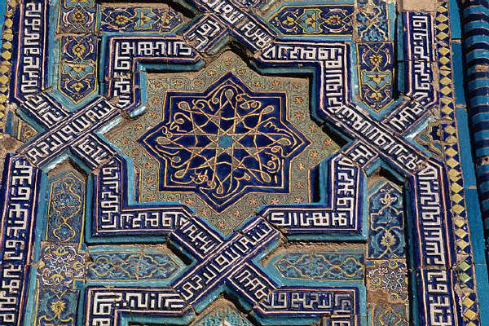
Geometric Patterns
Designed to symbolize the idea of infinity and Allah
Used to show the order and unity of nature as created by Allah
Influenced by mathematical discoveries made by Muslim scientists and thinkers

Slide 11
Architecture
One of the most important Muslim art forms
Greatest architectural achievement was the mosque
Built to look like the courtyard of Mohammed's house in Medina where he led the community in prayer
Included such details as minarets, domes, arches, mihrab, ablution fountains, prayer halls, colored bricks, and decorated tiles
Notes:
Minarets used to call people for prayer times
Domes let in light
Mihrabs. Semicircular niches indicating the direction of Mecca
Ablution fountains allow water for washing rituals before prayers

Slide 12
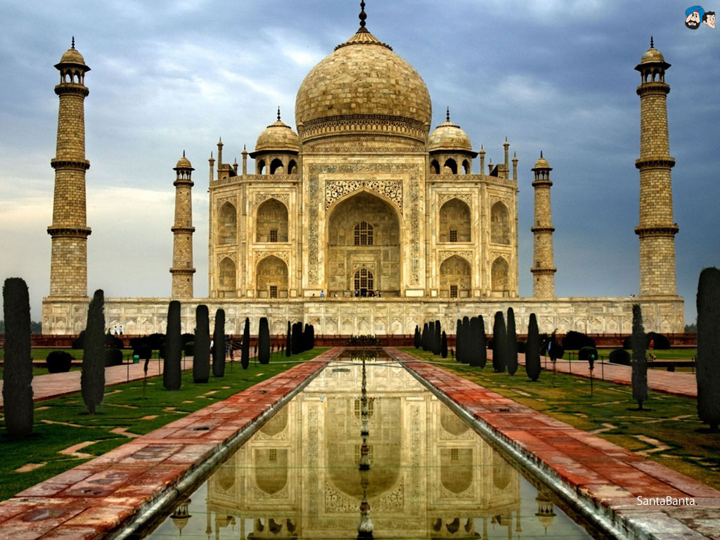
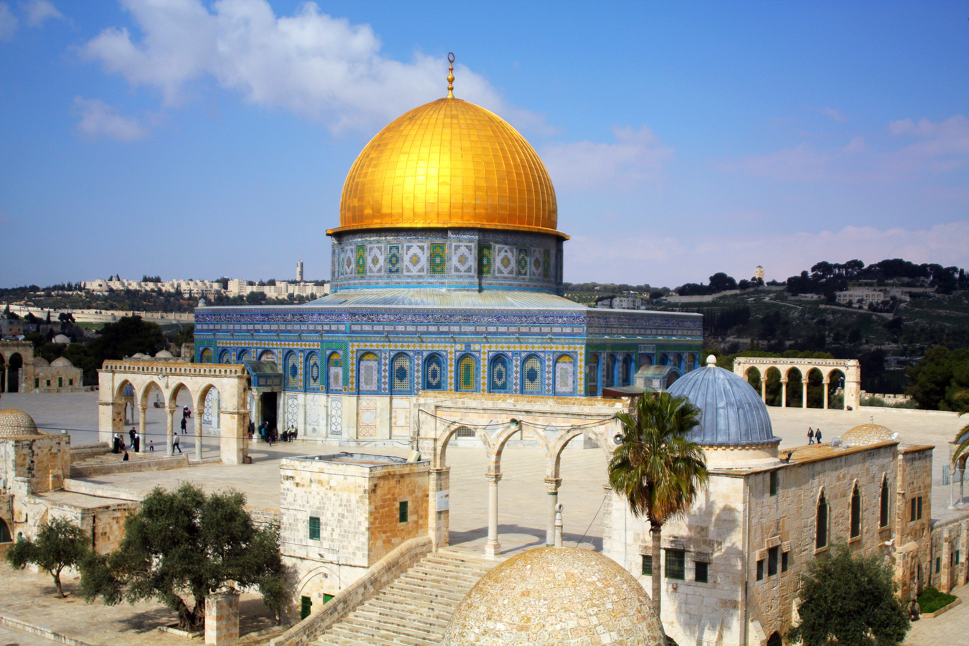
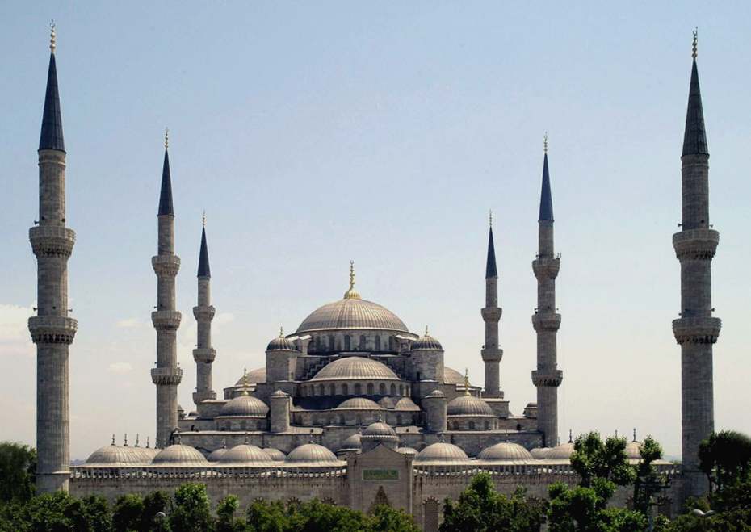
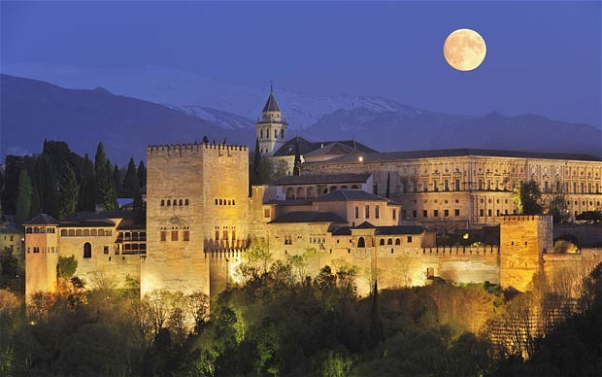
Notes:
Blue Mosque in Turkey
Alhambra palace in Spain
Taj Mahal in India and the
Dome of the Rock in Jerusalem
BBC video fountains 29:43-32:09

Slide 13
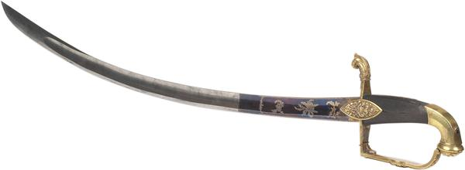
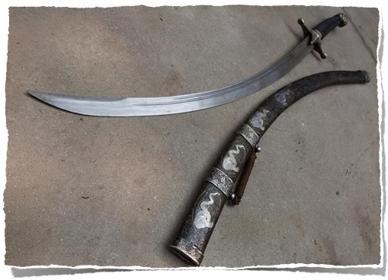
Weaponry
Scimitar
Surpassed in quality by only the Japanese katana

Slide 14
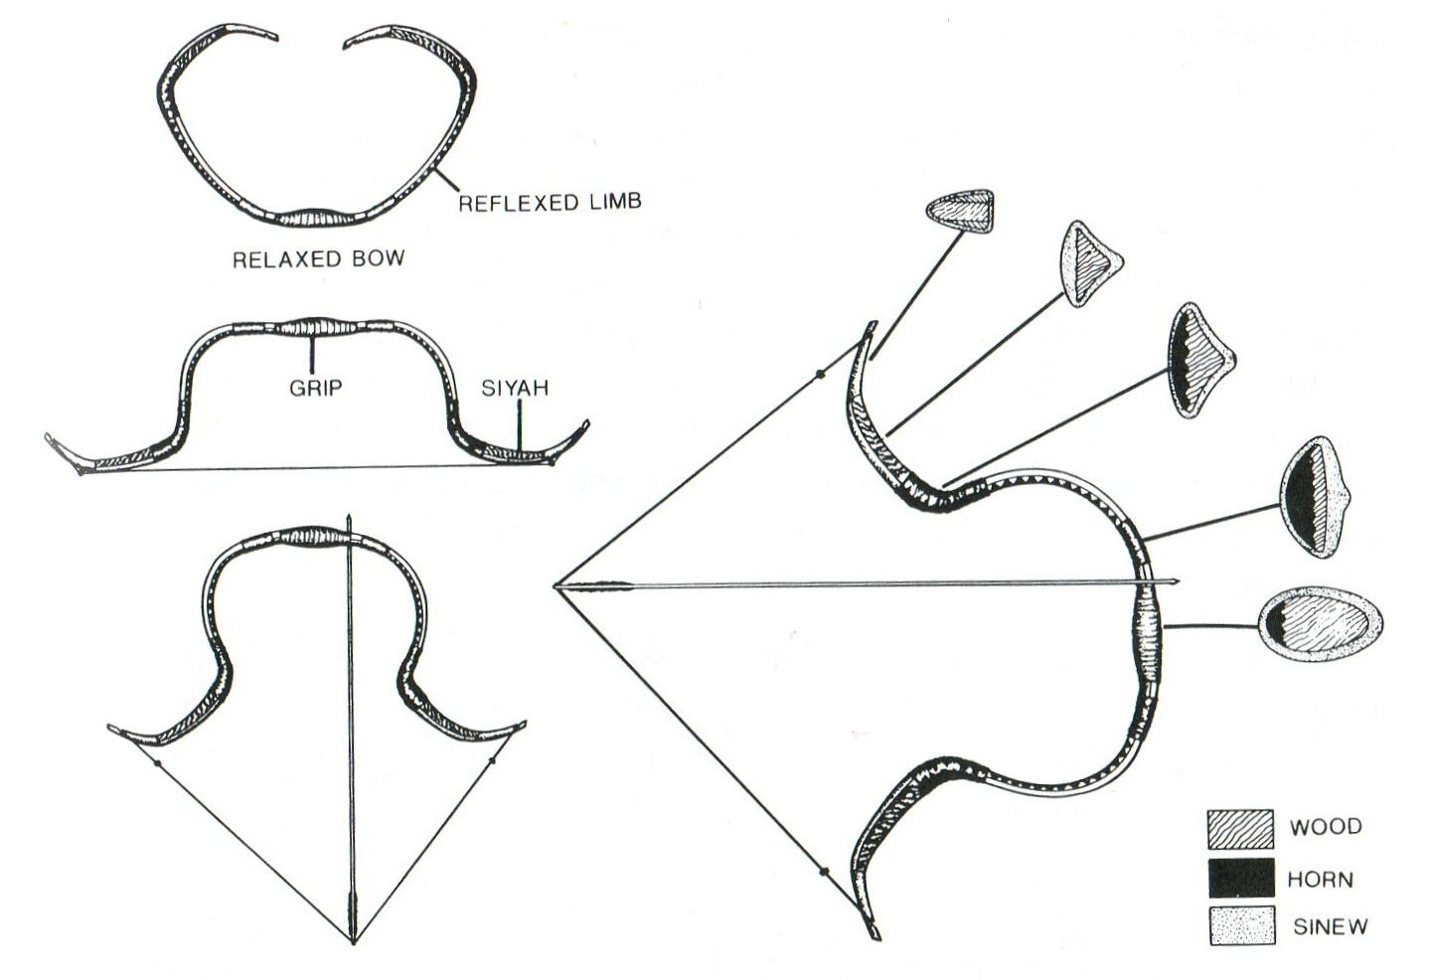
Composite recurve bow
Notes:
Bows quickly became the most important weapon used by Muslim soldiers. Muslim bows were typically more compact than bows used by European archers. Unlike European bows, which typically were crafted from a single piece of wood, Muslim archers used composite bows made of layers of wood, horn, ivory and sinew. The use of layered materials allowed Muslim bows to produce equal force with much shorter draw lengths, allowing Muslim archers to fire faster than those equipped with long bows. The shorter composite bows also were much easier to fire from horseback -- a tactic increasingly used by Muslim armies beginning in the 10th century.
BBC video 52:50-56:34

