Slide 1
Geography
G

Slide 2
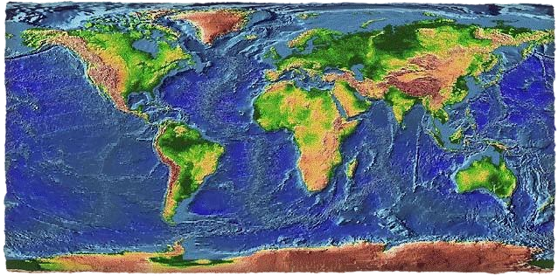
Geography
Definition: a field of science dedicated to the study of the lands, the features, the inhabitants, and the phenomena of the earth
The bridge between the human and physical science

Slide 3
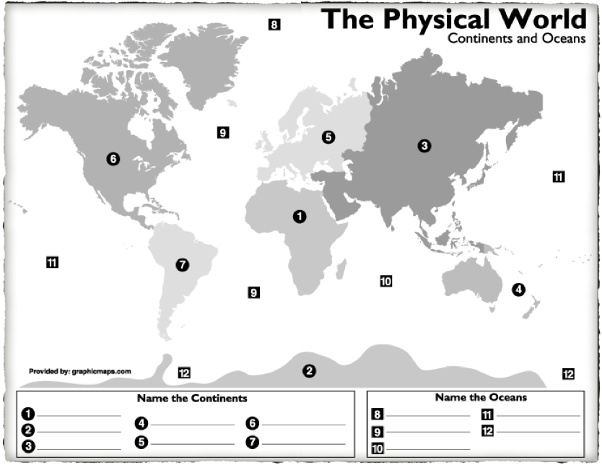
Expectations
Point to region on a map; which continent(s)?

Slide 4
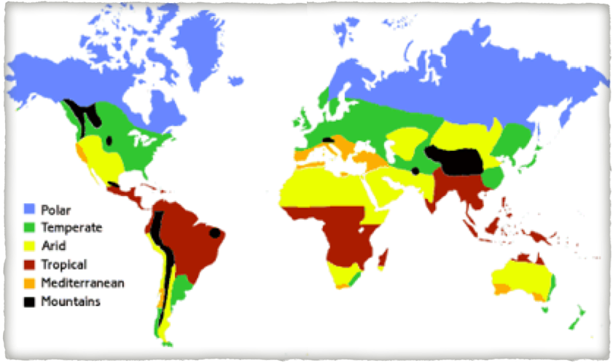
What is the climate?

Slide 5
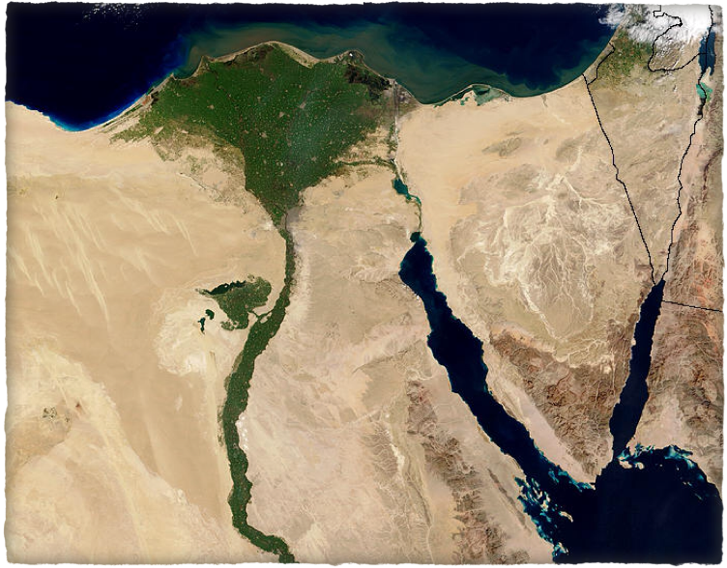
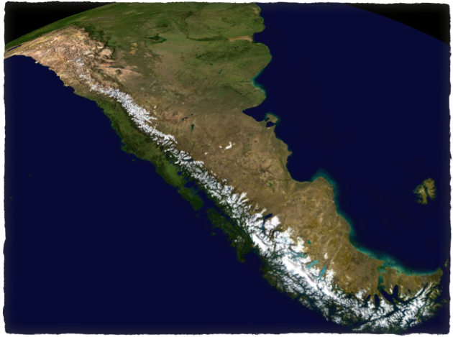
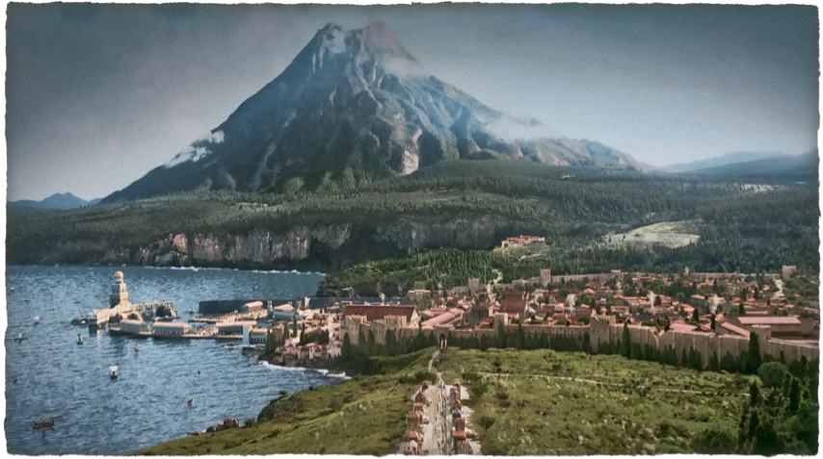
What are some of the physical features?

Slide 6
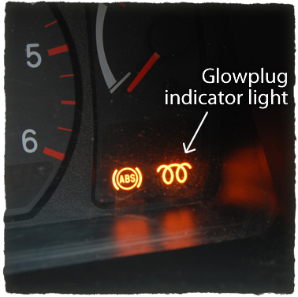
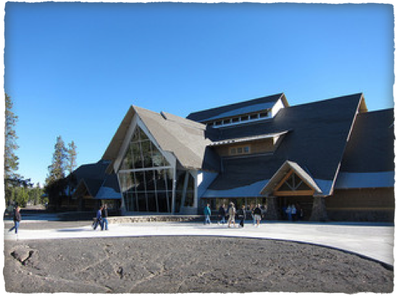
How does geography affect us?
Architecture
The question we are trying to answer is...
Transportation
Fashion
Food

