Slide 1
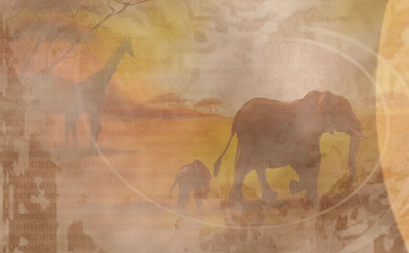
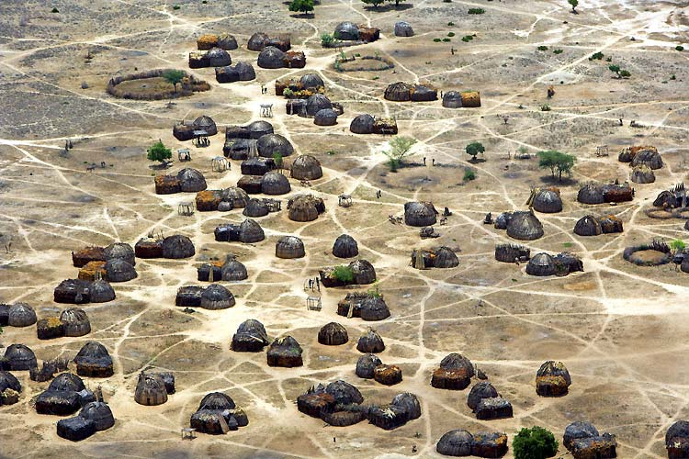
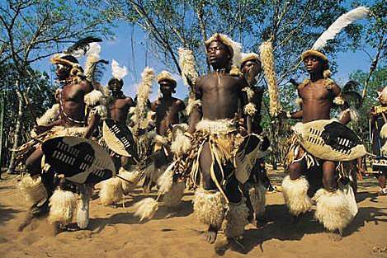
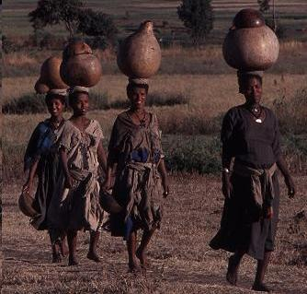
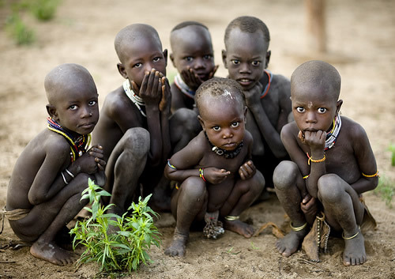
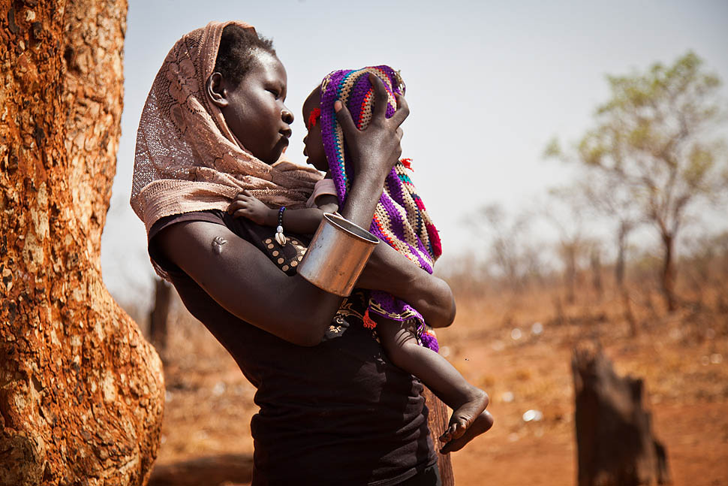
African Society

Slide 2
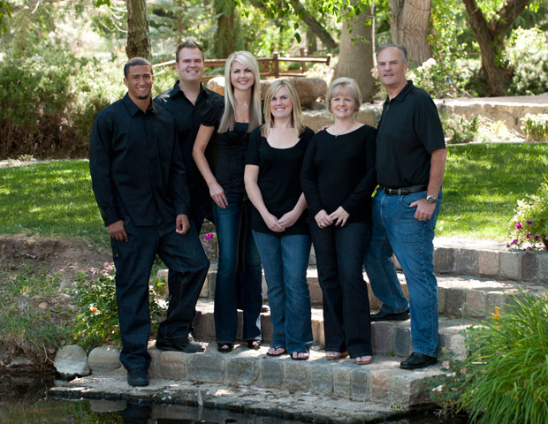
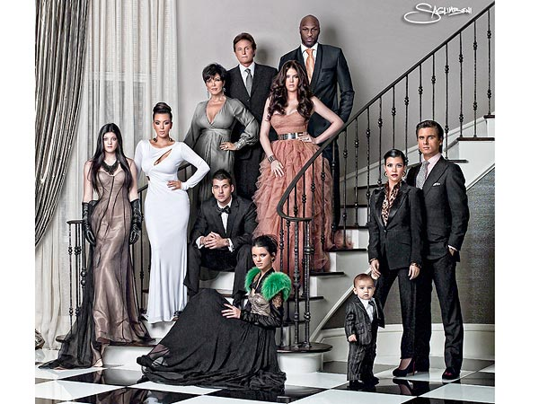
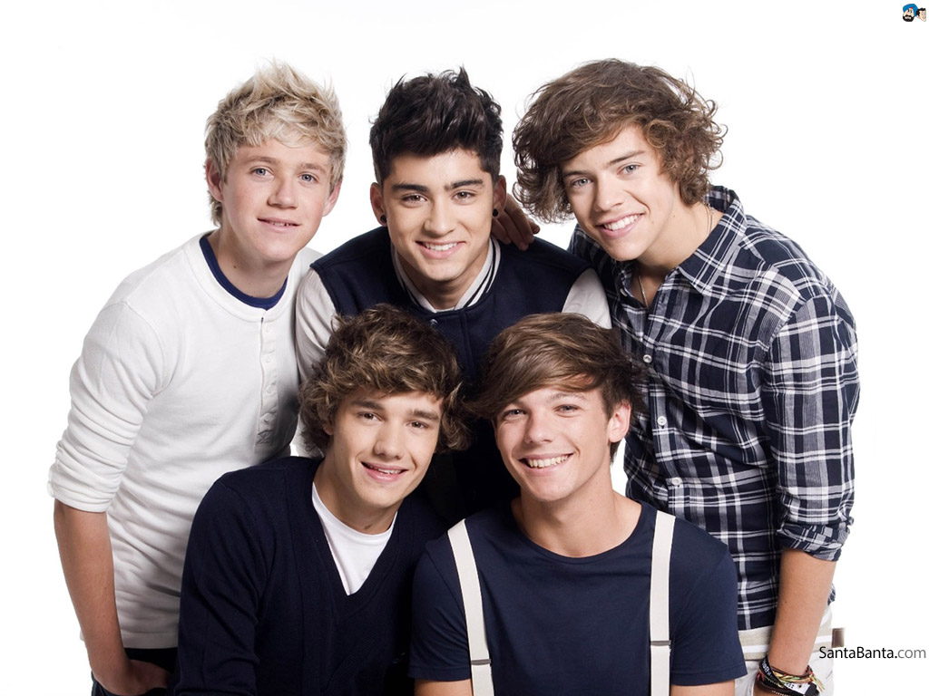
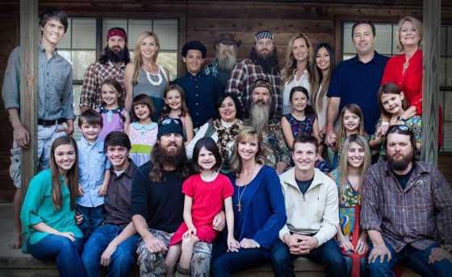
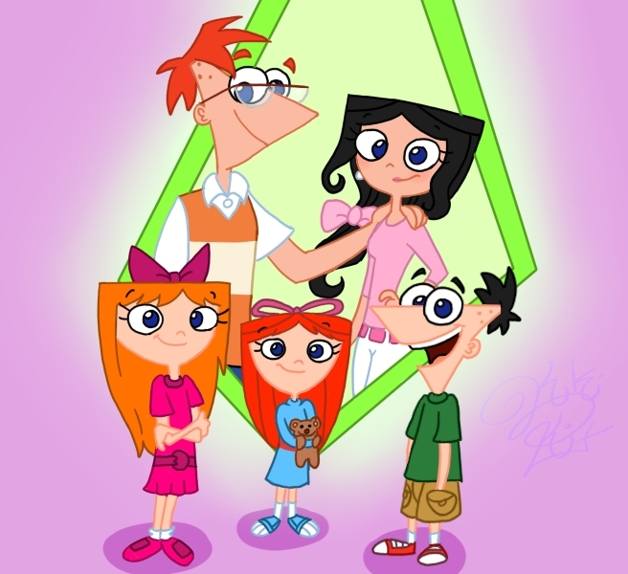
Tribe:
Societies organized largely on the basis of social, especially familial, groups
Nuclear family
Extended family
Age-sets
Clan: United by perceived kinship
Lineage - ancestry

Slide 3
Pros
Cons
Tribal unity, loyalty
Tribe more important then nation
Good of the tribe comes ahead of the individual
Civil/Tribal warfare
Strong traditions, culture, religion
Communication
Honor and respect for ancestors
Nepotism - favoritism
Simple government

Slide 4
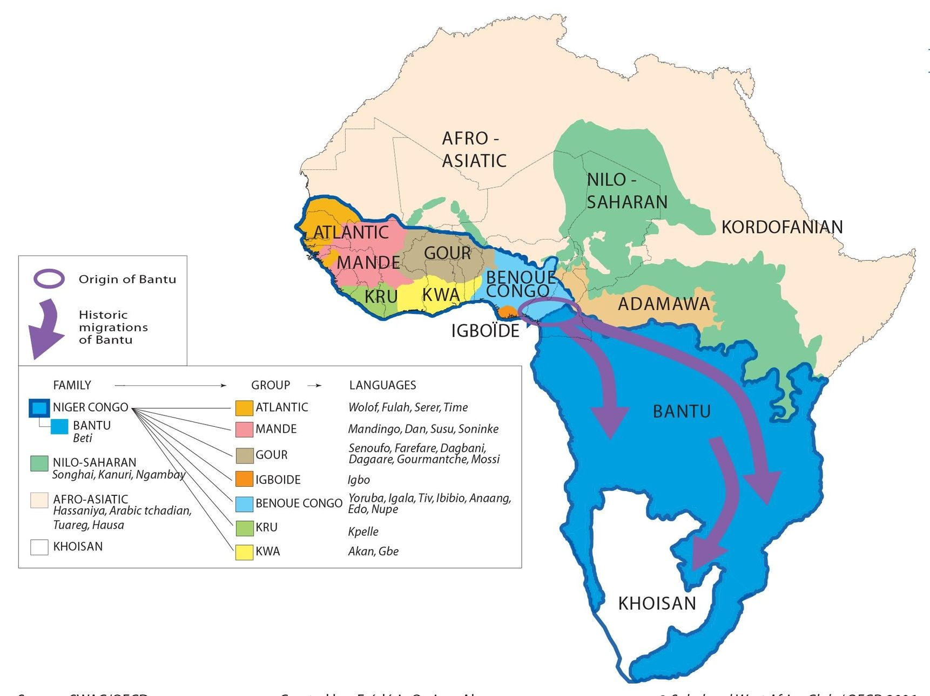

Slide 5
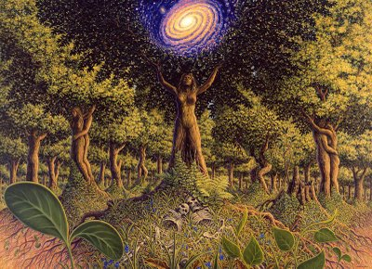
African Religion
Animism

Slide 6
encompasses the belief that there is no separation between the spiritual and physical (or material) world, and souls or spirits exist, not only in humans, but also in some other animals, plants, rocks, geographic features such as mountains or rivers, or other entities of the natural environment, including thunder, wind, and shadows.
Supreme creator
Ancestor veneration
Belief in magic and charms
Mediator between tribe and Creator

Slide 7
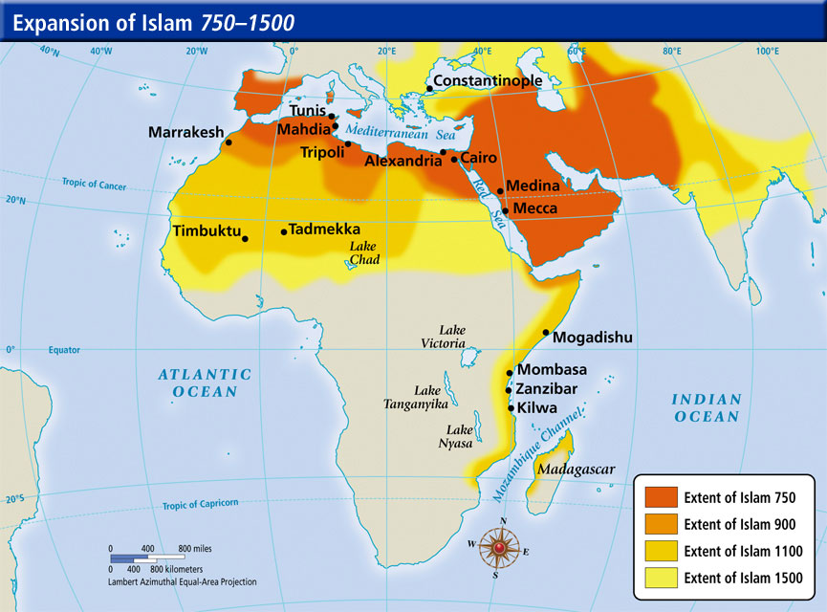
What do animism Islam and Christianity have in common?
Monotheism
Name change: creator - Allah - Jesus

Slide 8
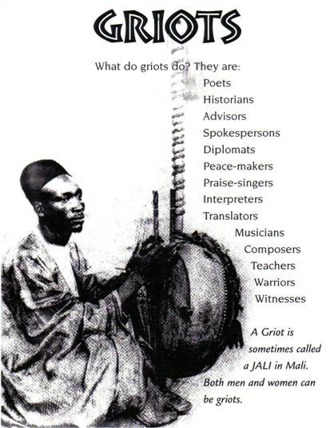
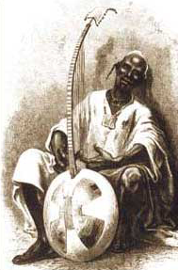
African Griot
story teller
European bard
valued by kings and chiefs
Kora - 21 string lute or harp

